Slide 1
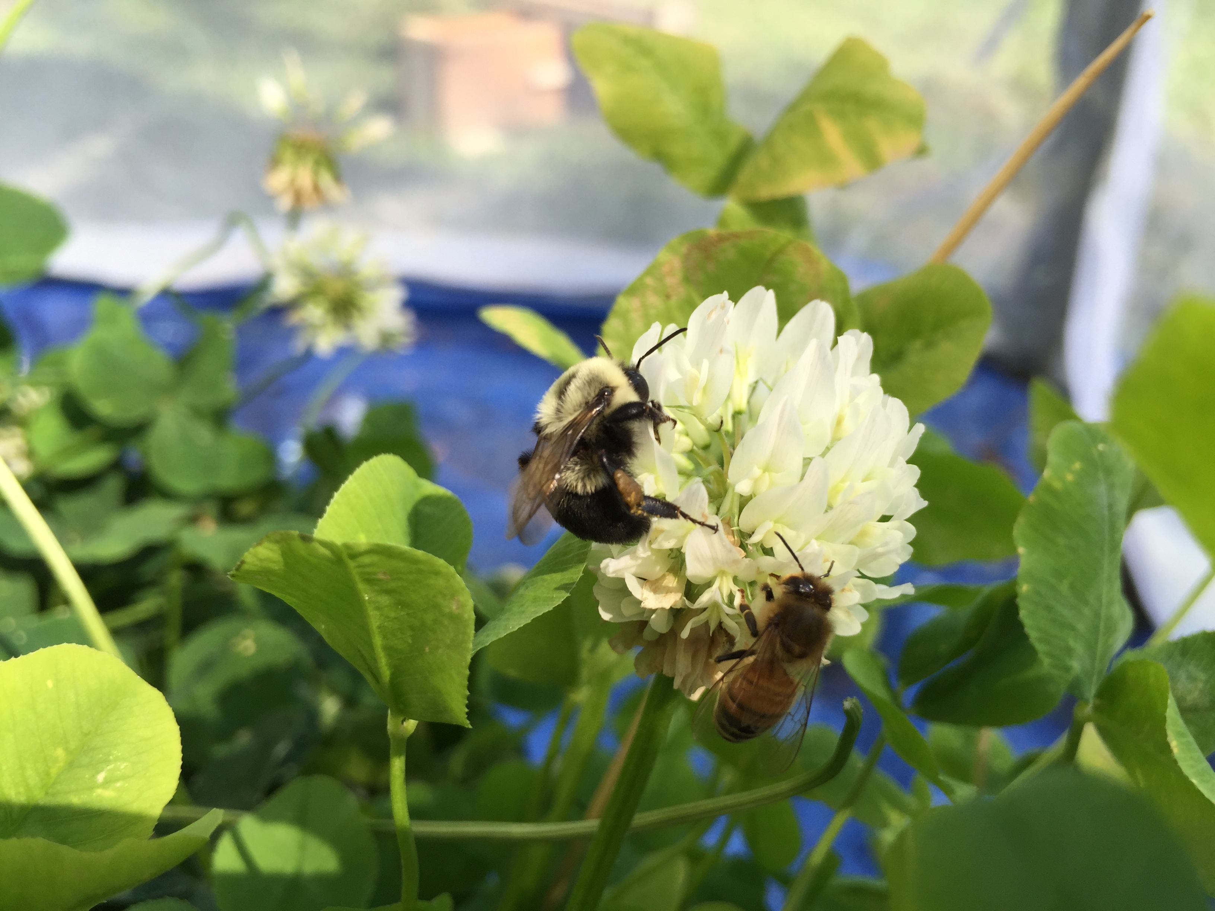

Bee Virus Ecology
Samantha Alger Alex Burnham
Ph.D. Candidate Ph.D. Student
Biology, Evolution and Ecology
University of Vermont

Slide 2
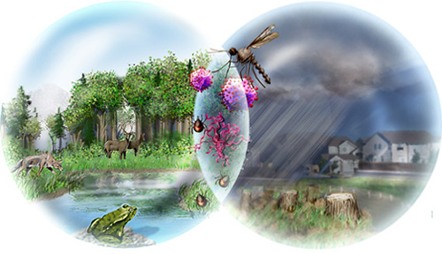
Disease Ecology
Study of interactions among wildlife hosts, vectors, pathogens, and their environment
Prevalence?
What influences disease spillover?
When do outbreaks occur?
How does the environment influence interactions between hosts and pathogens?
Nicolle Rager Fuller, NSF
Notes:
The study of this whole system of plants-insects-and their pathogens fits broadly under the growing discipline of Disease ecology. Disease ecologists like myself and Alex are interested in learning about pathogens in a holistic way: Rather than studying pathogens in isolation, we want to understand how the surrounding ecology influences the patterns we see. We ask questions like: what’s the prevalence….. But also.. How does the environment influence prevalence and outbreaks.

Slide 3
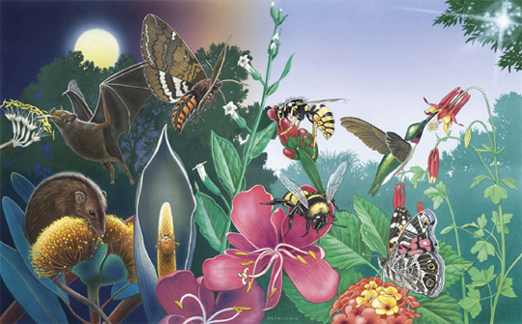
Paul Mirocha
Notes:
Plants and their animal pollinators have evolved together for millions of years. Plants depend on pollinators for reproduction and pollinators depend on plants for food. When we look out at our garden in the summer, we as entomologist and beekeepers, see many interactions, not only pollinators visiting flowers but we also see herbivores eating plants, predators in search of prey, and flowers are also places of aggregation for mate finding.

Slide 4
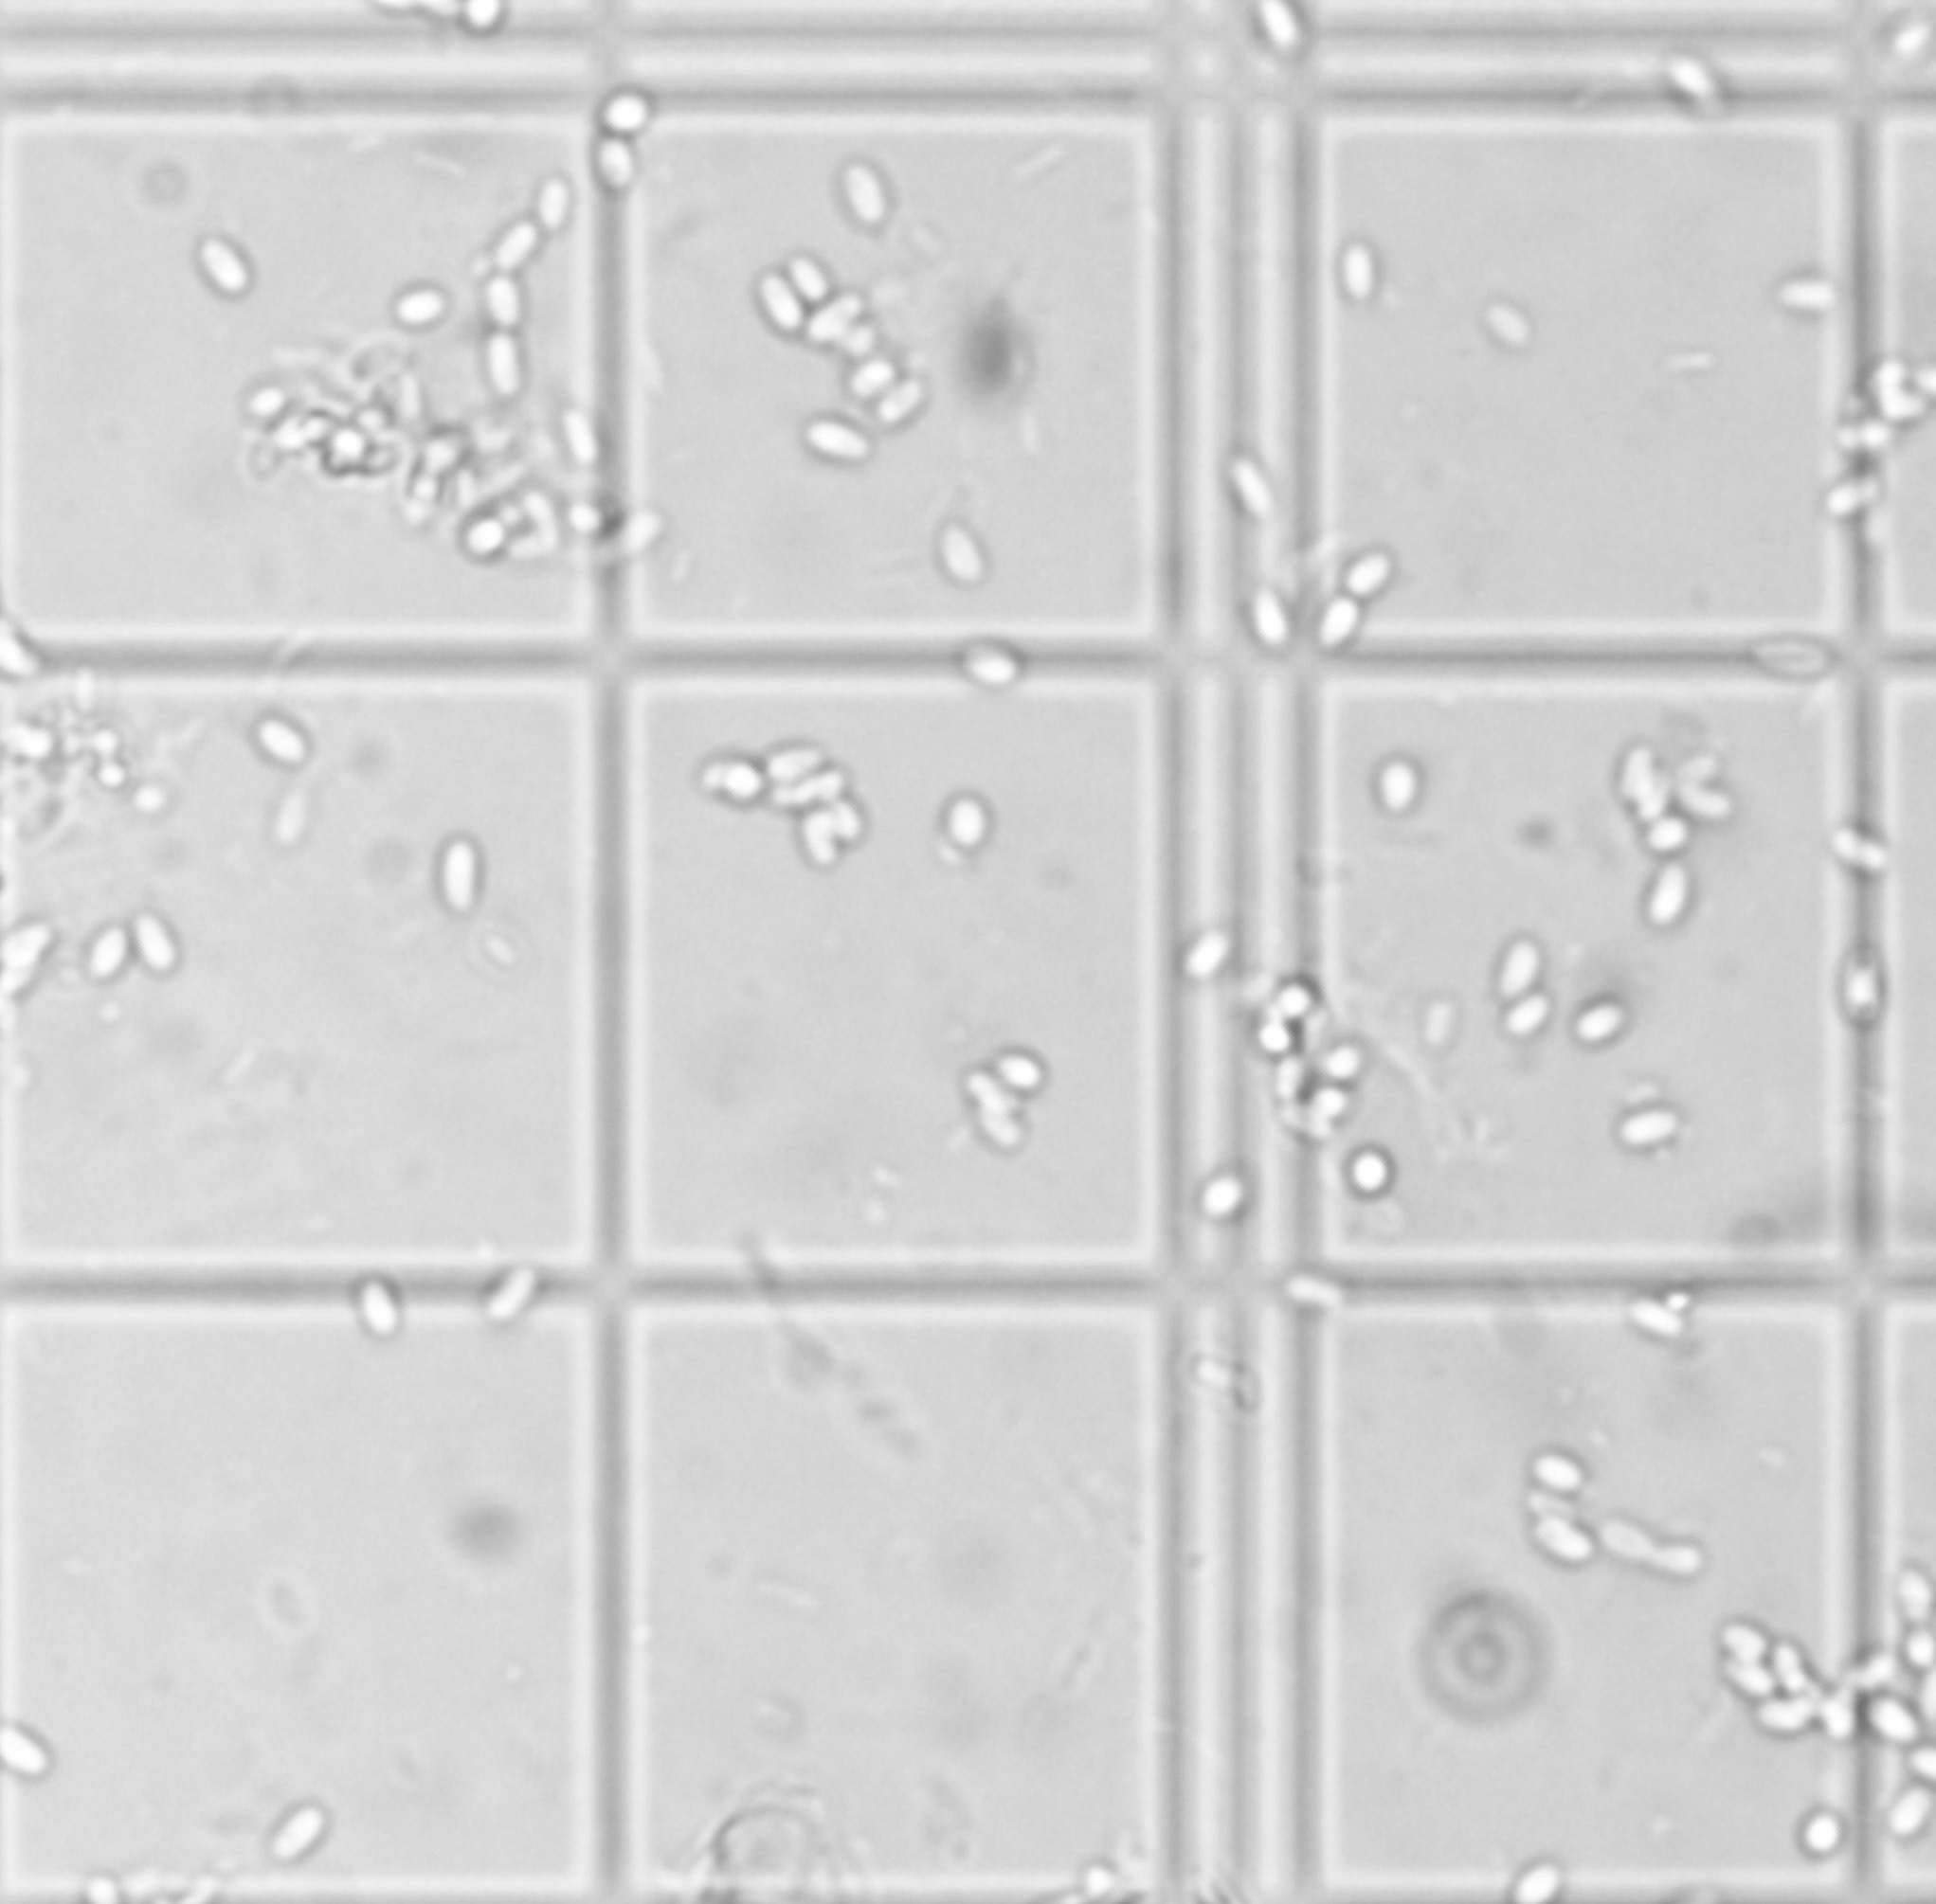
Notes:
Through millions of years of evolution, plants have become intense places of aggregation for insects. But, if you zoom in even closer, and view the world from a disease ecologist, we can see another world… The world of the pathogens and parasites. Successful pathogens are those able to spread, evolve, and infect new hosts. By taking advantage of the close association of insects and plants, by either hitching a ride on an insect to get to another plant, or playing the ‘sit and wait’ game on a flower to infect an insect visitor, pathogens can be quite successful.

Slide 5
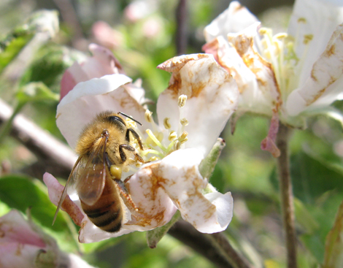
Plant-Insect-Pathogen Interactions
Fire Blight - (Bacteria): Infects nectar secretion site in apples and pears, carried by bees
Mummy berry disease - (Fungus): Infects blueberry stems and wilted leaves become ‘pseudoflowers’ that attract insect visitors with ‘nectar’, UV, and scent
Crithidia & Nosema spp. (Trypanosome & Microsporidian): Infects bees through use of shared flowers, probably through feces, some plants may be better at harboring the diseases
utahpests.usu.edu

Slide 6
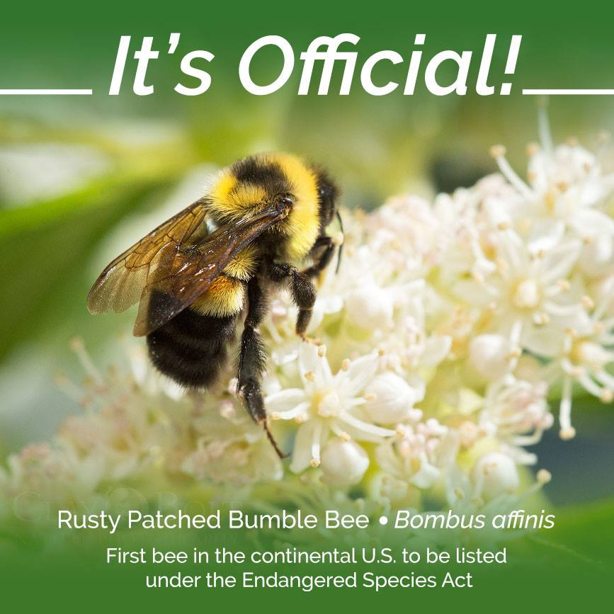
Xerces Society
Notes:
Pollinator decline and honey bee losses are bringing bee diseases to the interests of scientists….Most of what we know about bee diseases comes from the honey bee research. We know that pathogens have also played a role in both honey bee and native bee decline and we know that many bee species share many of the same diseases. However, we don’t really know the prevalence of diseases in wild bee species, how they are being affected, or how the diseases are being transmitted.

Slide 7
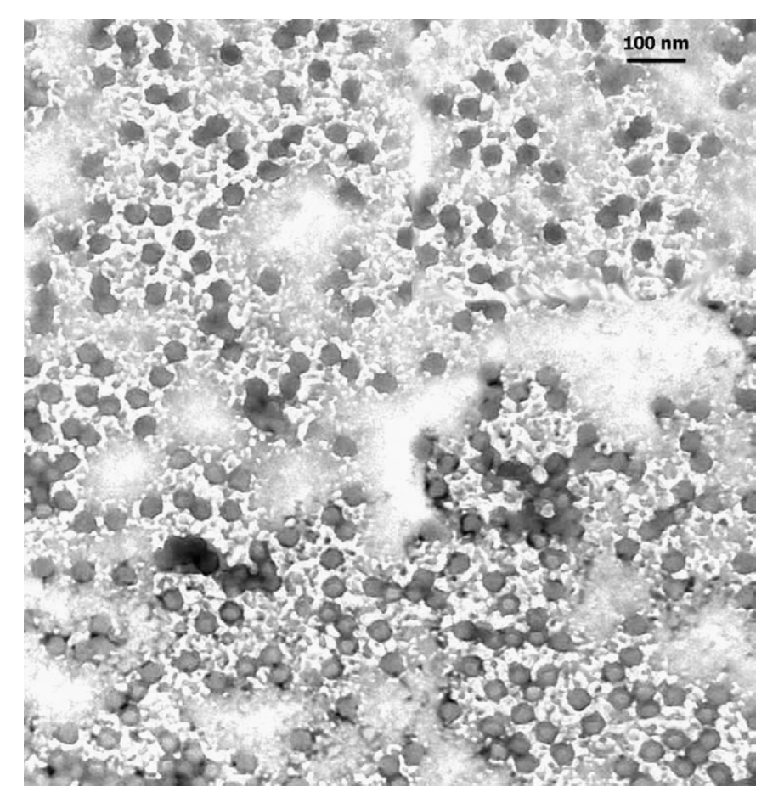
^{Deformed Wing Virus}
^{(DWV)}
^{Black Queen Cell Virus (BQCV)}
^{Israeli Acute Paralysis Virus}
^{(IAPV)}
Notes:
In particular, we know very little about the bee viruses.
The viruses we are interested in include DWV, BQCV, and IAPV. These common RNA viruses are thought to be ‘honey bee viruses’ and are best studied in honey bees. But, they have been found in many other insect species including beetles, ants, bumble bees, and solitary bees.
The success of viruses in general, as a pathogen depends on their ability to replicate within a host’s cell. Viruses don’t have the necessary molecules or machinery to replicate on their own. So, they literally ‘reprogram’ or ‘hijack’ the host cell’s machinery to do this for them. Because they cannot do this on their own, there’s debate whether viruses are actually living organisms.

Slide 8
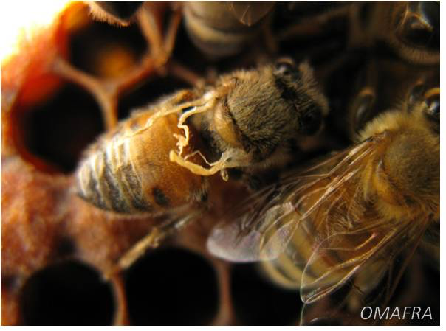
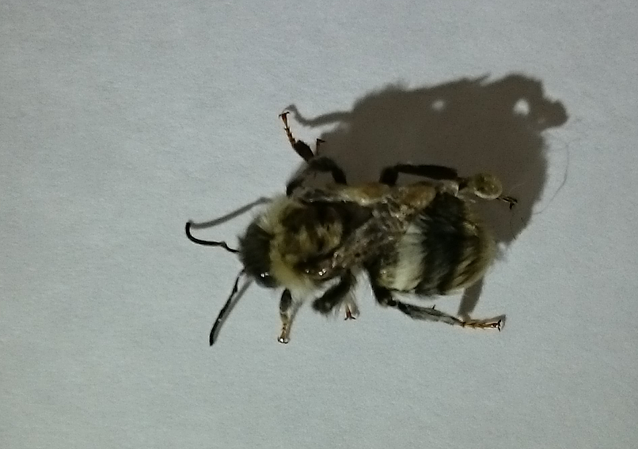
Deformed Wing Virus (DWV)
Honey bees
Bumble bees
Emily Bailes
Wing deformities
Bloated abdomen
Vectored by Varroa mites
Wing deformities (Genersch et al., 2006)
Survivorship (Furst et al. 2014)

Slide 9
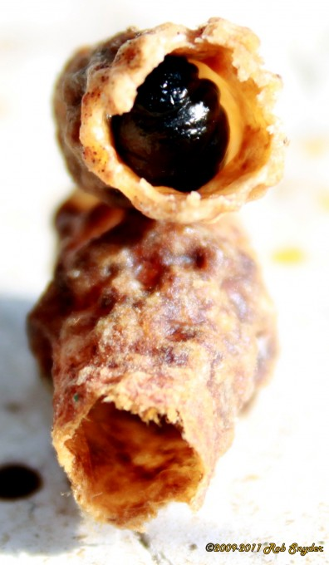
Black Queen Cell Virus (BQCV)
Honey bees
Bumble bees
?
Blackened and dead queen cells
No obvious symptoms in adult bees
Uncertain if vectored by Varroa mites
Unknown

Slide 10
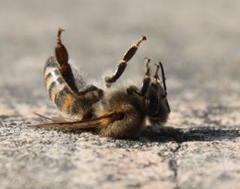
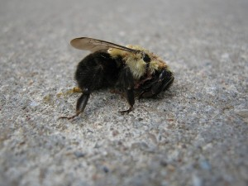
Israeli Acute Paralysis Virus (IAPV)
Honey bees
Bumble bees
Kutsuks/iStockphoto
Paralysis, trembling, death
Vectored by Varroa mites (Chen et al., 2004; Shen et al., 2005; 2005; DiPrisco et al., 2011)
Kills pupae during development
Strong negative selection pressure on transmission by Varroa (Sumpter and Martin, 2004)
Reduced offspring production (oral innoculation) (Meeus et al., 2014)
Rapid mortality (injection) Niu et al., 2014
Paralysis, trembling, immobilized forelegs (injection) (Wang et al., 2016).

Slide 11
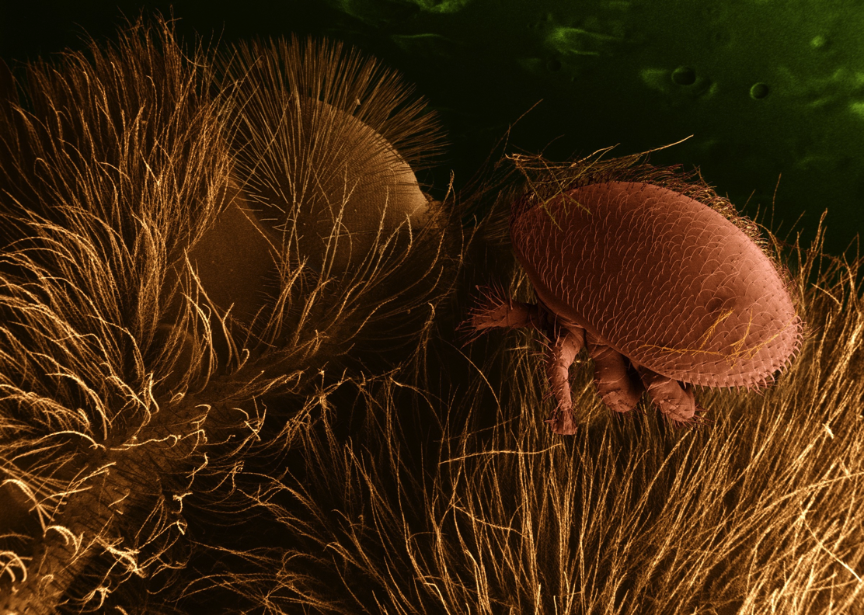
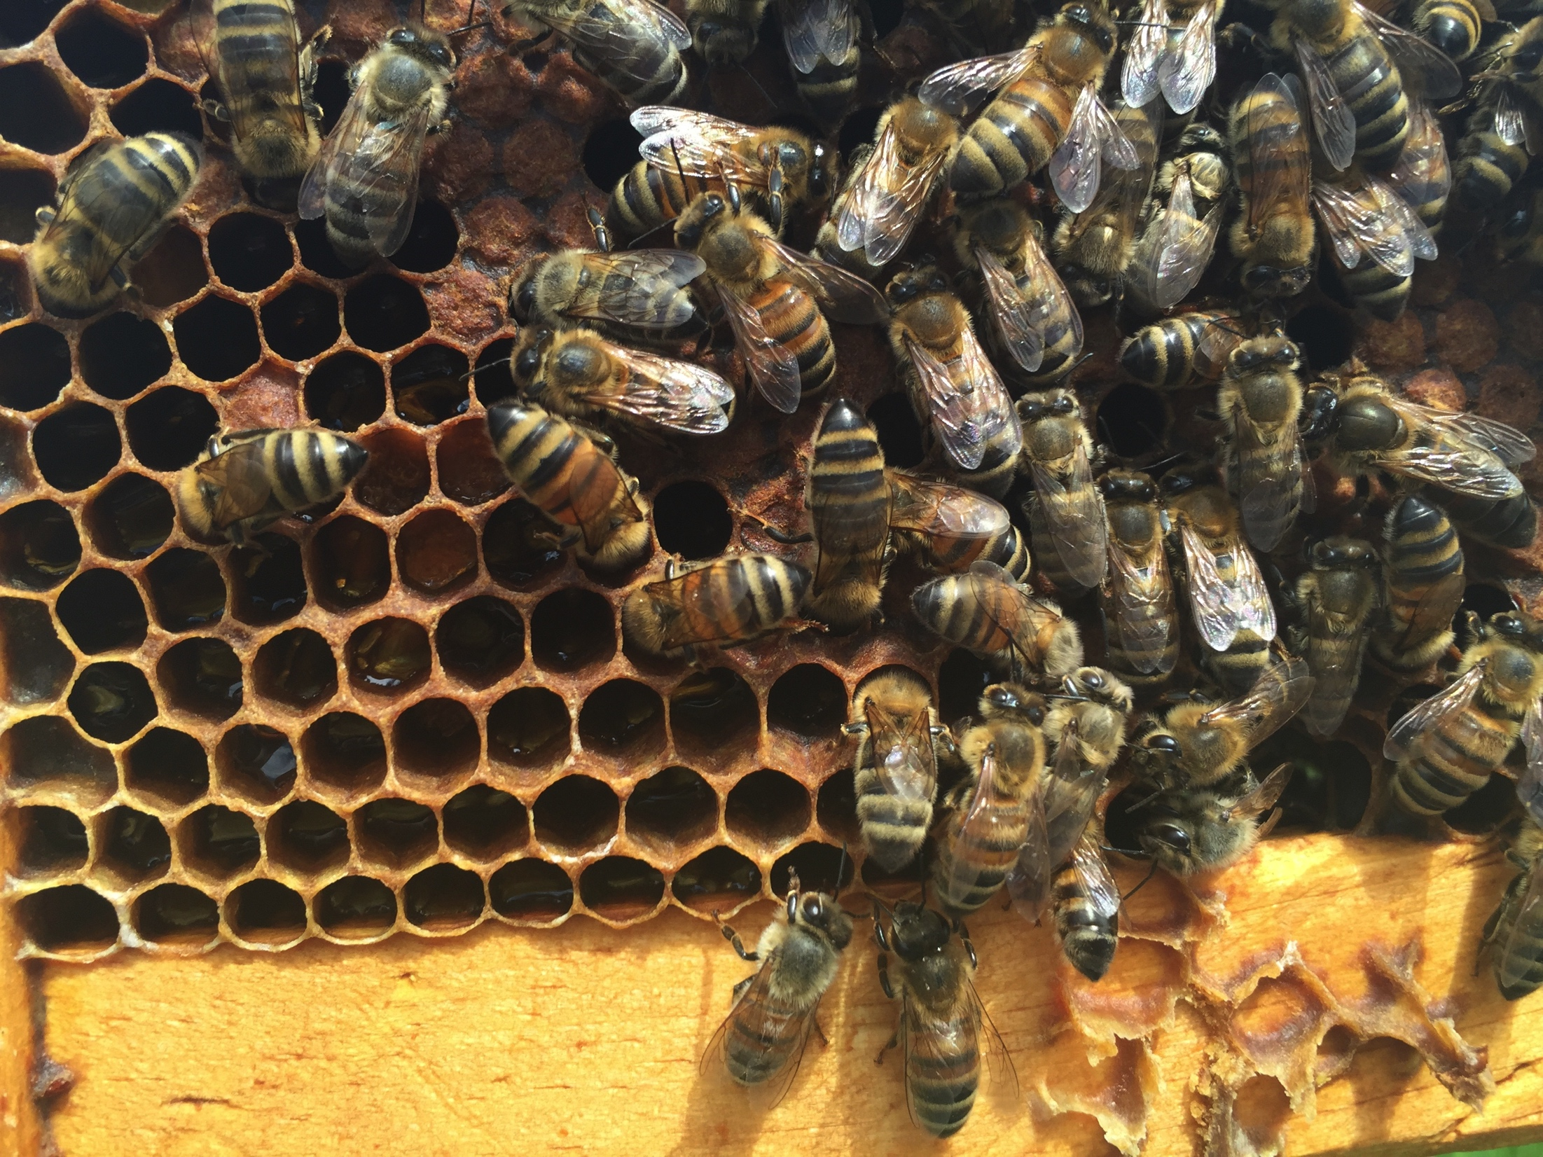
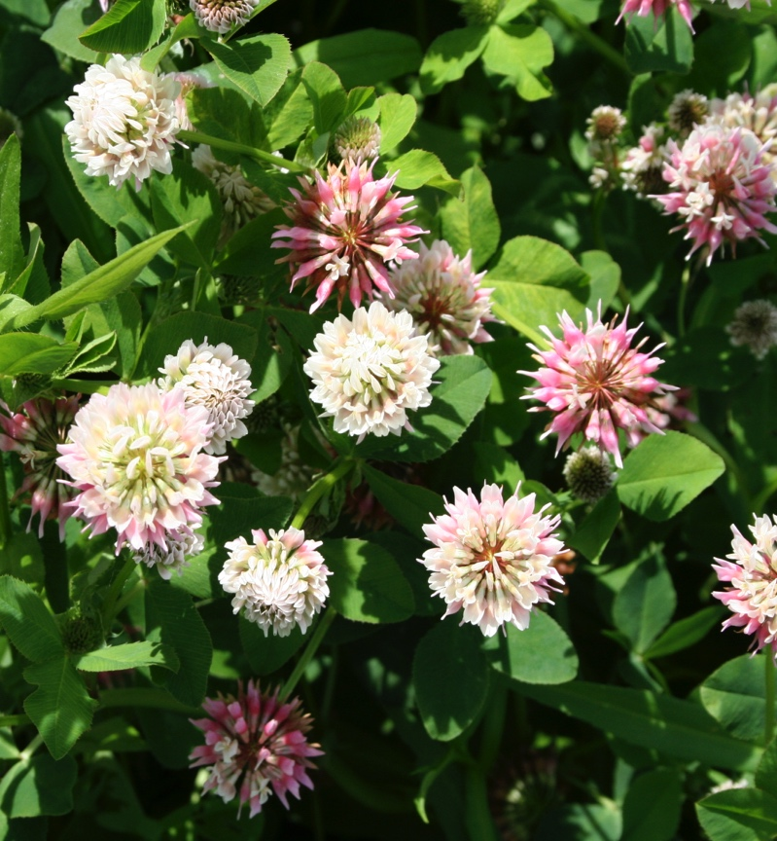
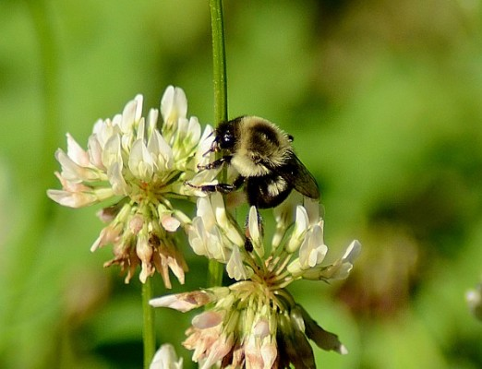
Notes:
So, you’ll remember me saying that these viruses are found in many other insect species, so how are they getting around? In the case of DWV and IAPV, mites vector viruses to honey bees. But other bee species like bumble bees are not known hosts of mites…. The standing hypothesis is through the use of shared floral resources.

Slide 12
Research Questions
Part I.
What is the prevalence of RNA viruses in bumble bees?
Is there evidence for disease spillover from managed honey bees?
Part II.
Can flowers act as bridges in disease transmission?

Slide 13
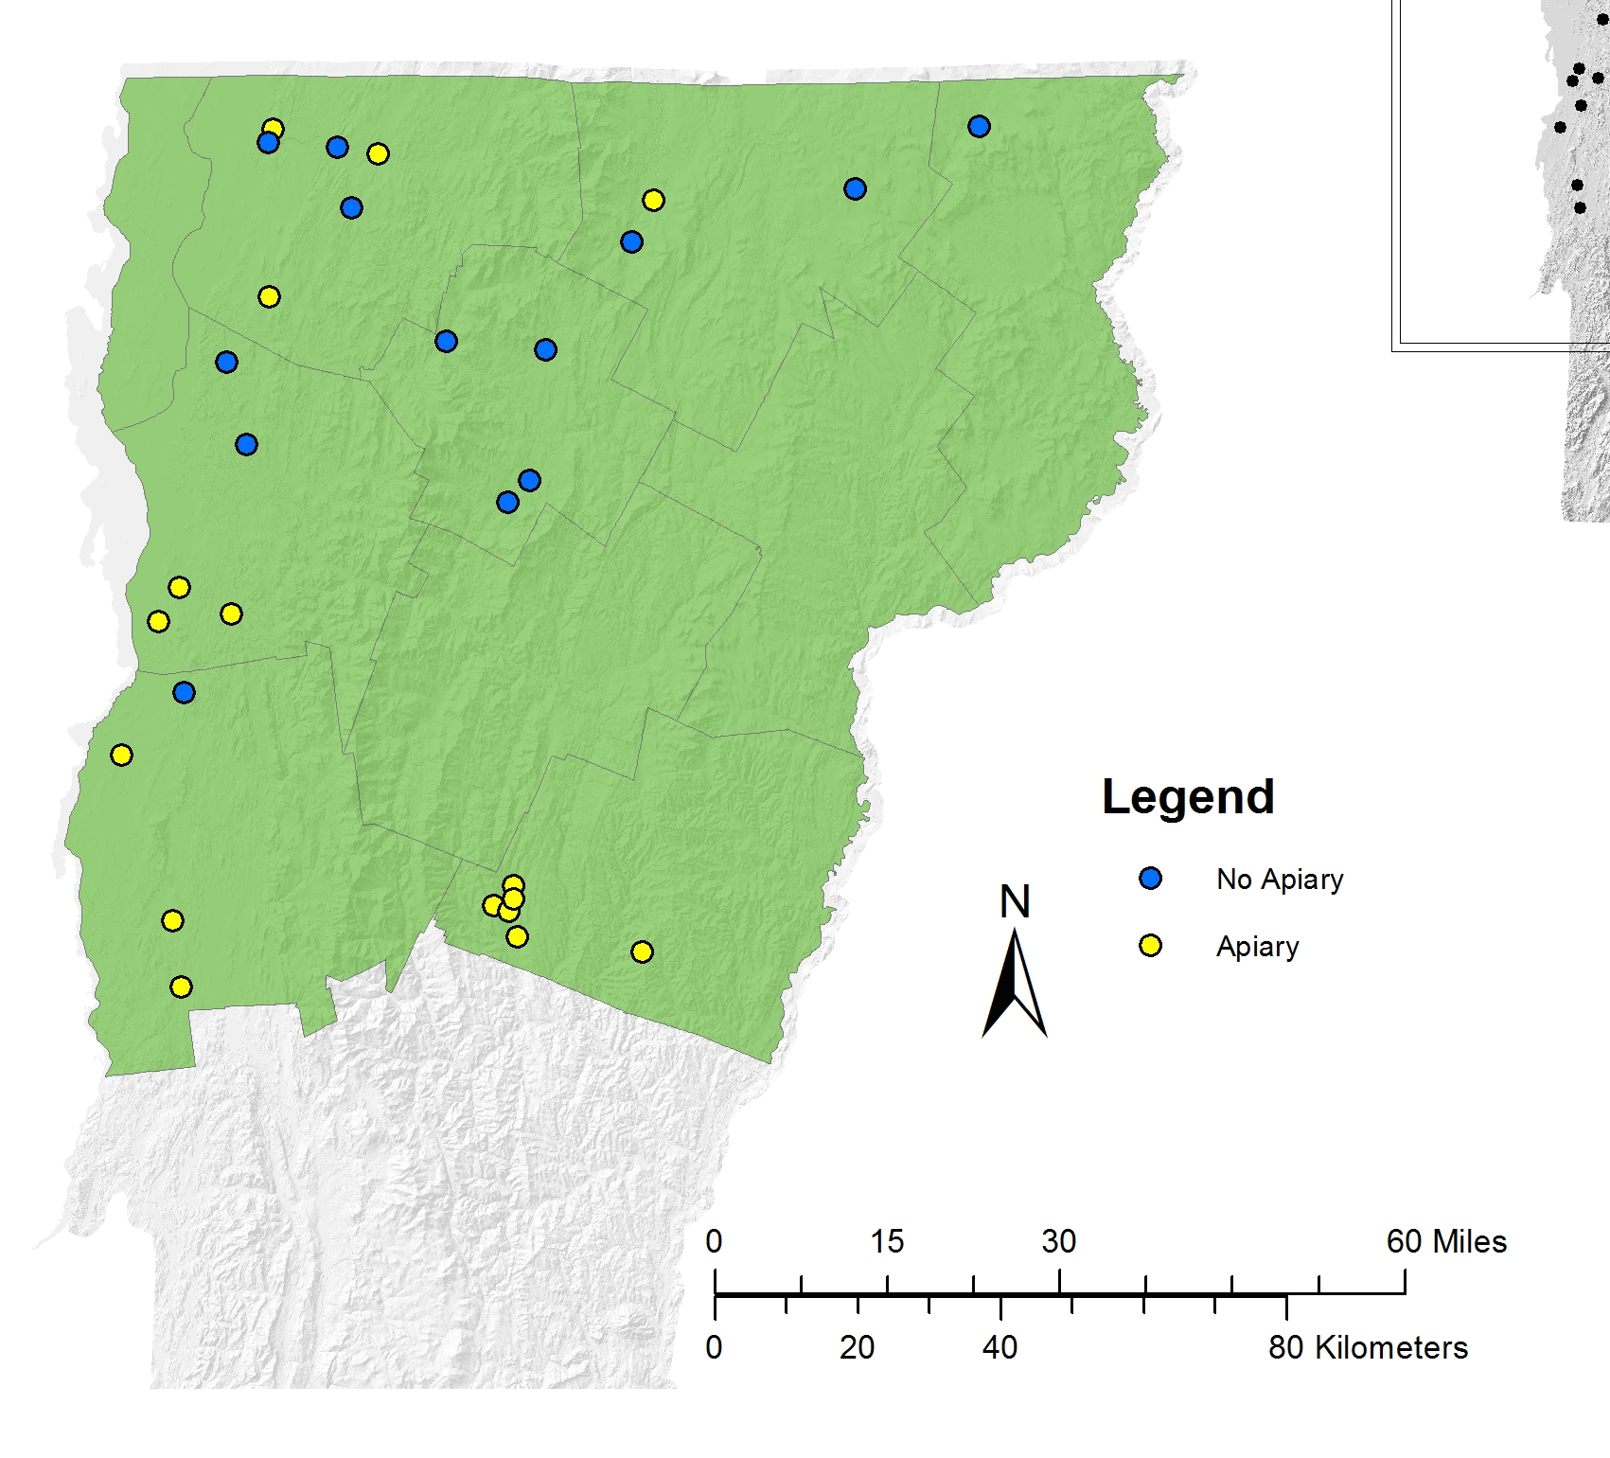
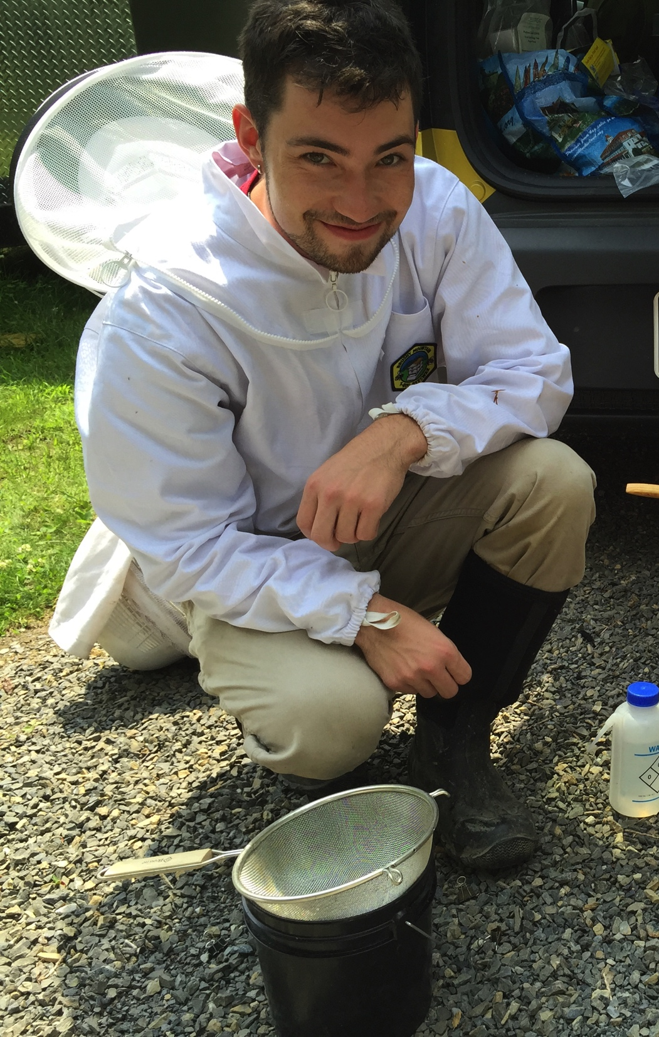

Slide 14
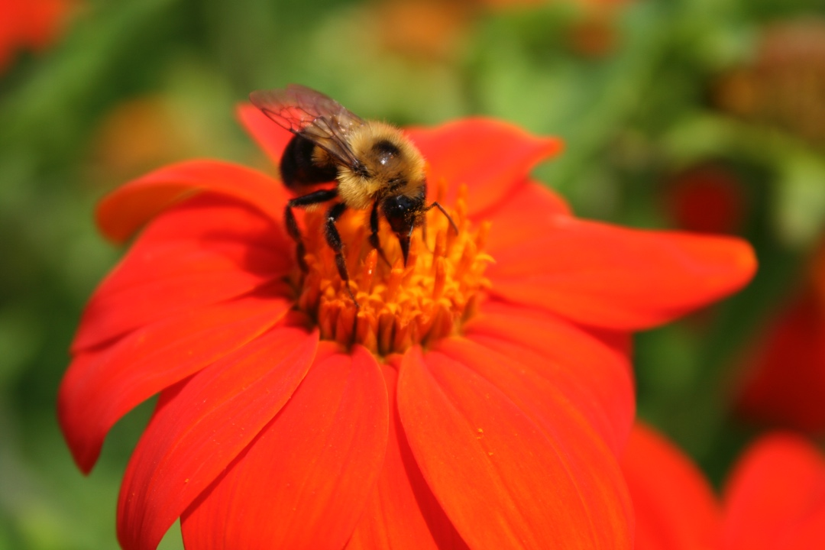
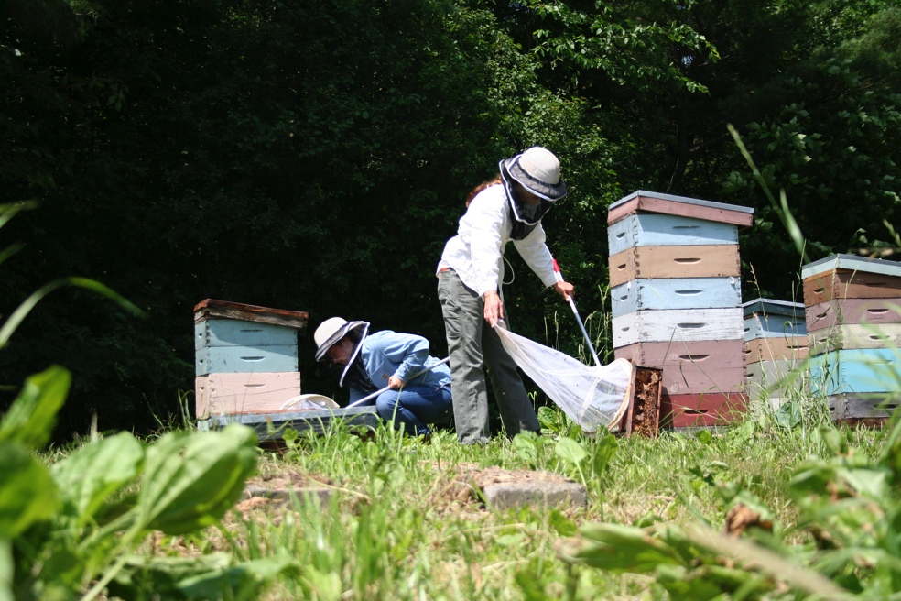
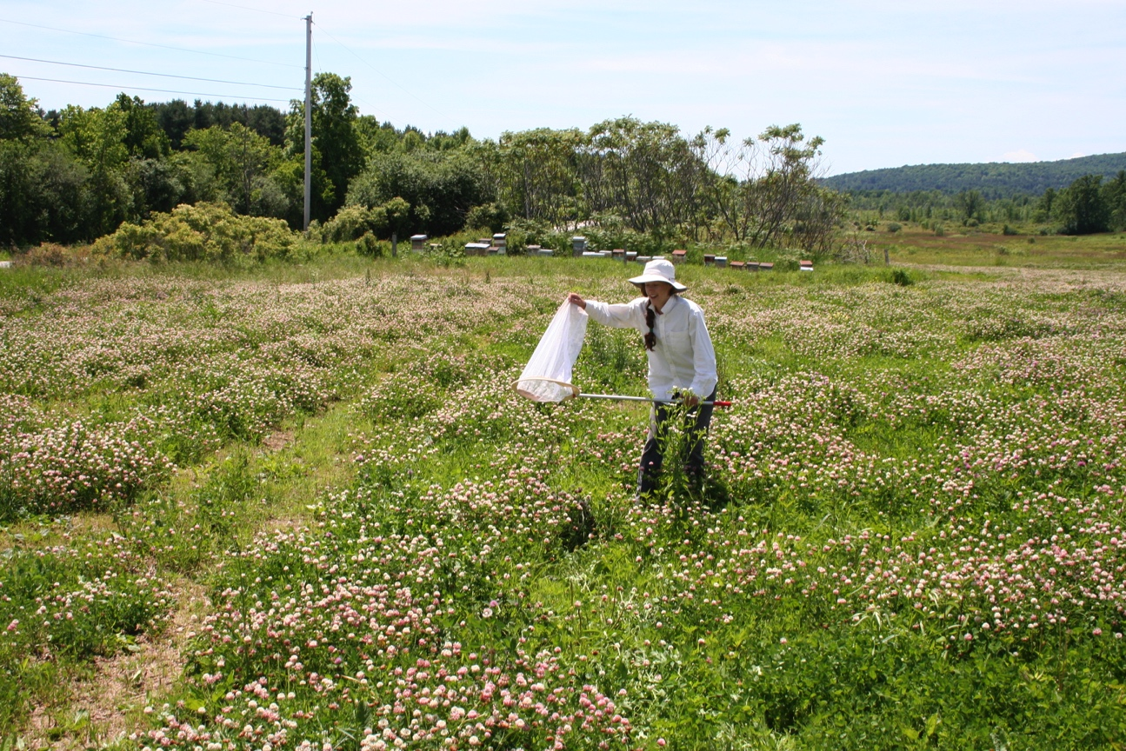

Slide 15
BQCV and DWV Detected in VT Bumble Bees

Slide 16
BQCV More Prevalent in bimaculatus
*
*

Slide 17
Viruses More Prevalent in Bumble Bees near Apiaries
*
*
*

Slide 19
Honeybee Viral Load Results: Either High or Low

Slide 20
More DWV infected Bumble bees in Sites with High Honey Bee Viral Loads
0% 5% 10% 15% 20%
% Prevalence (Bombus with DWV)
High HB DWV Load
Low HB DWV Load
No Apis Found
Site Type

Slide 21
Research Questions
Part I.
What is the prevalence of RNA viruses in bumble bees
BQCV is most common, followed by DWV
Is there evidence for disease spillover from managed honey bees?
Yes- bumble bees are more likely to be infected when caught near an apiary and when the apiary has high viral loads
Part II.
Can flowers act as bridges in disease transmission?

Slide 22
Research Questions
Part I.
What is the prevalence of RNA viruses in bumble bees
BQCV is most common, followed by DWV
Is there evidence for disease spillover from managed honey bees?
Yes- bumble bees are more likely to be infected when caught near an apiary and when the apiary has high viral loads
Part II.
Can flowers act as bridges in disease transmission?

Slide 23
?
Notes:
Can viruses be left behind by bees when they forage? Can bumble bees become infected after visiting infected flowers? We are still processing the bee samples but we are going to show you the plant data today.

Slide 24
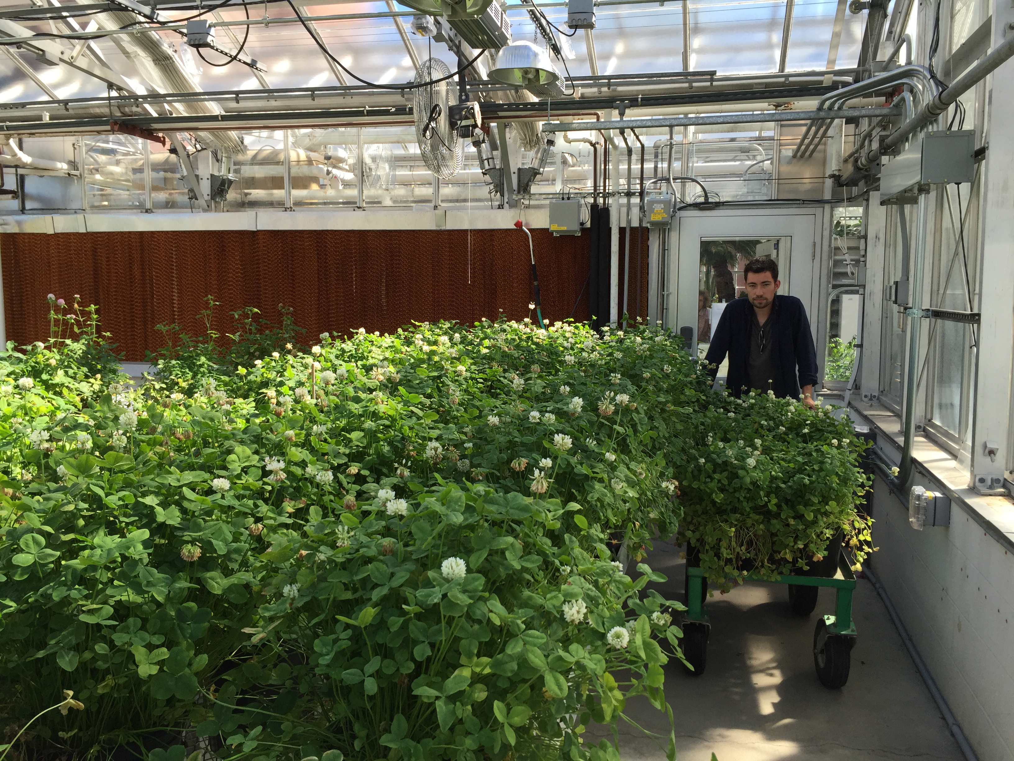

Slide 25
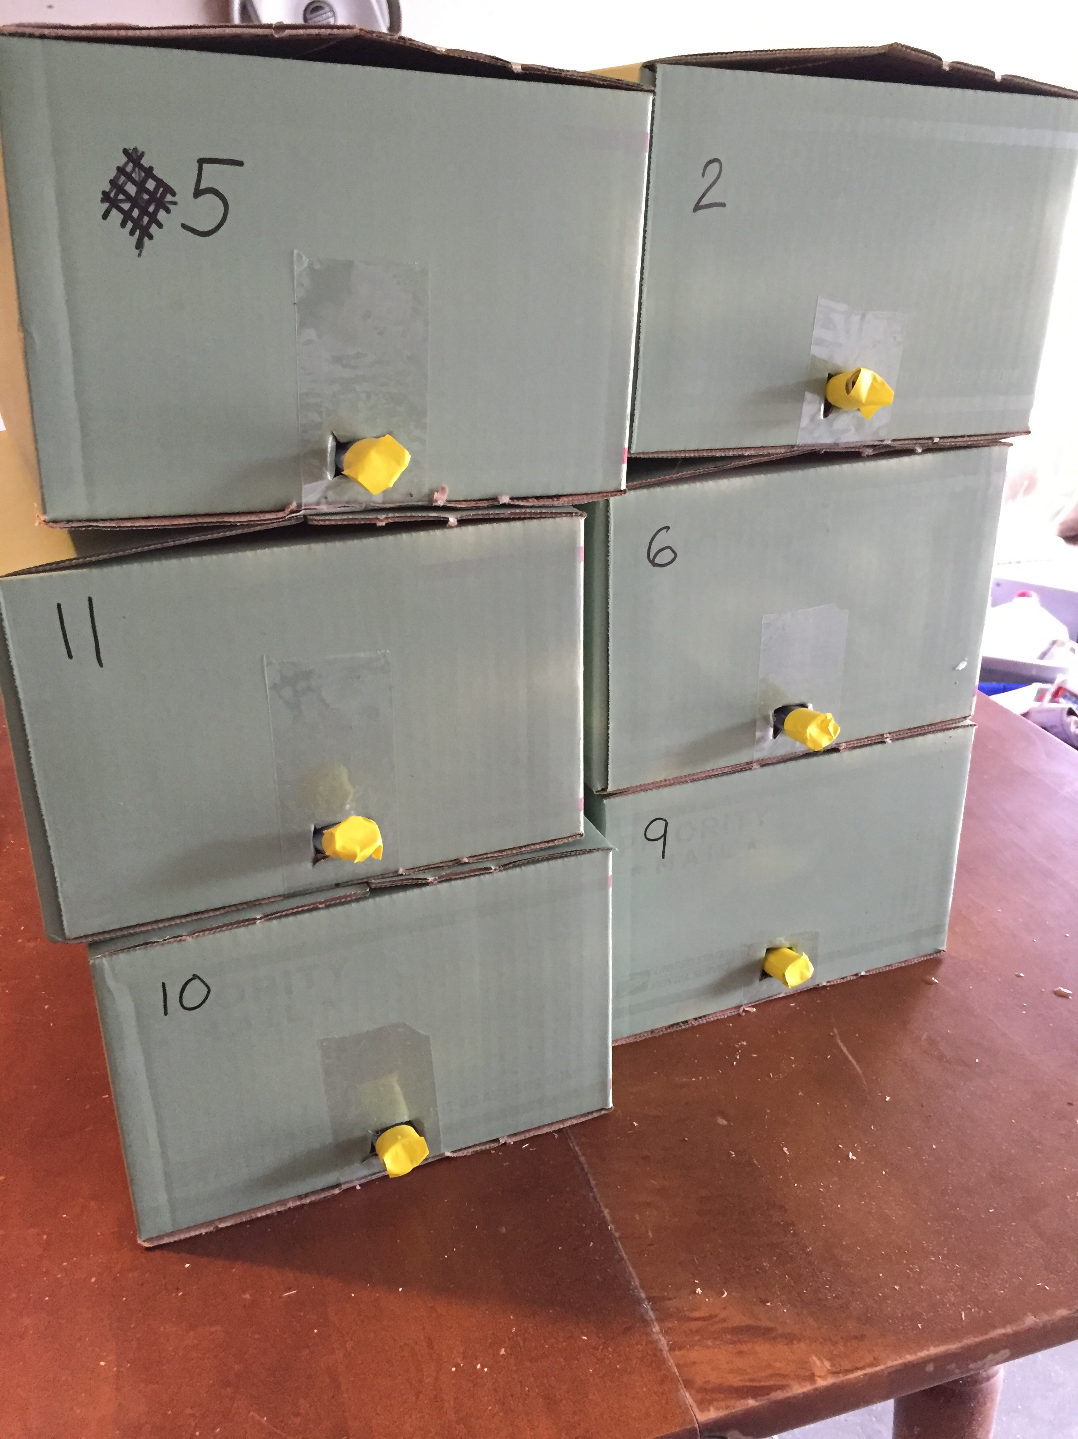
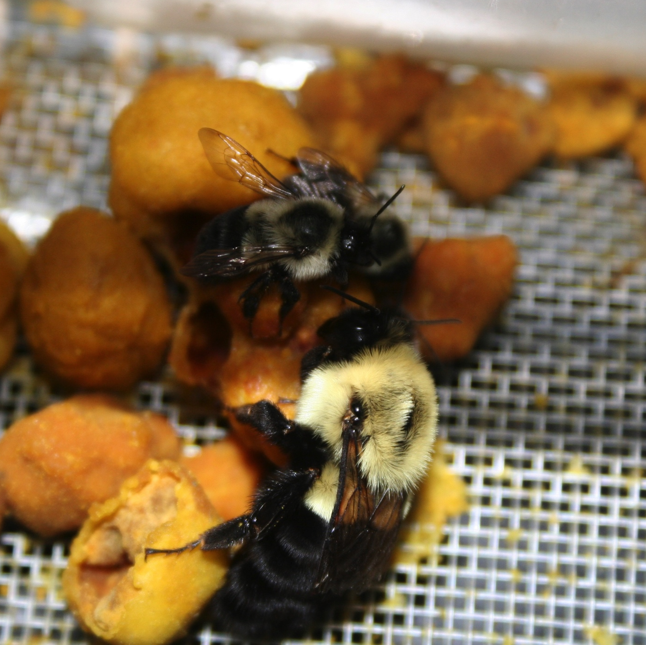

Slide 26
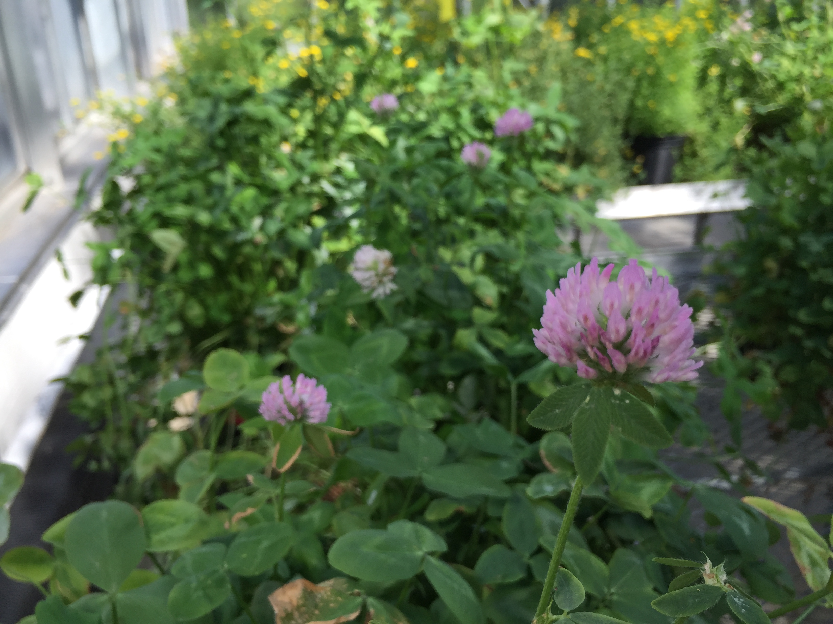
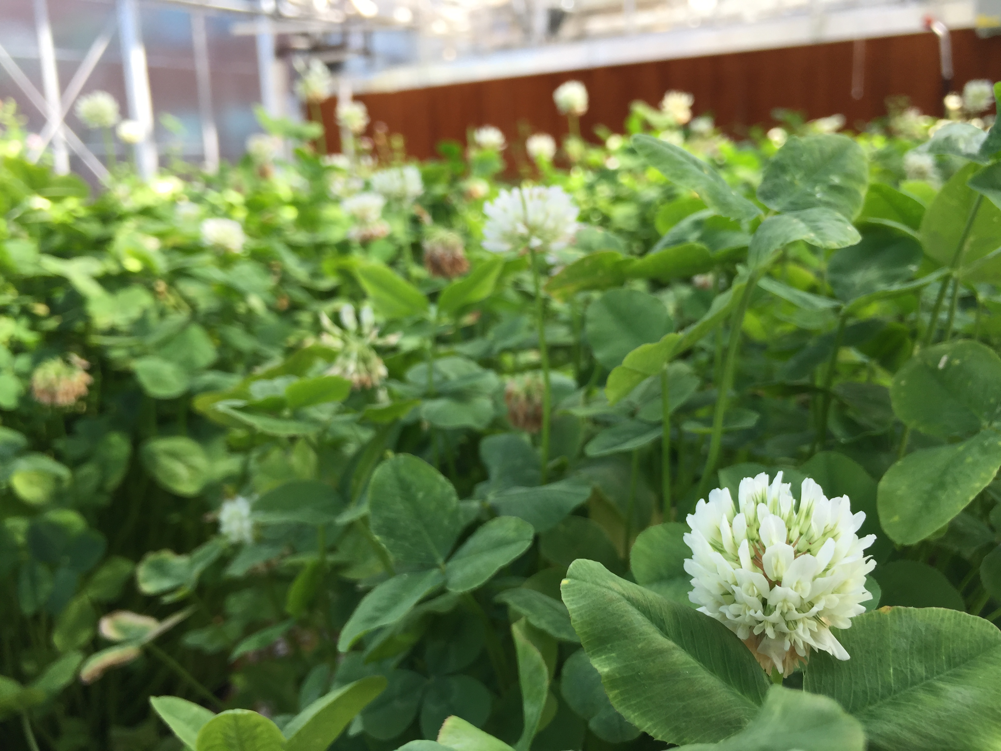
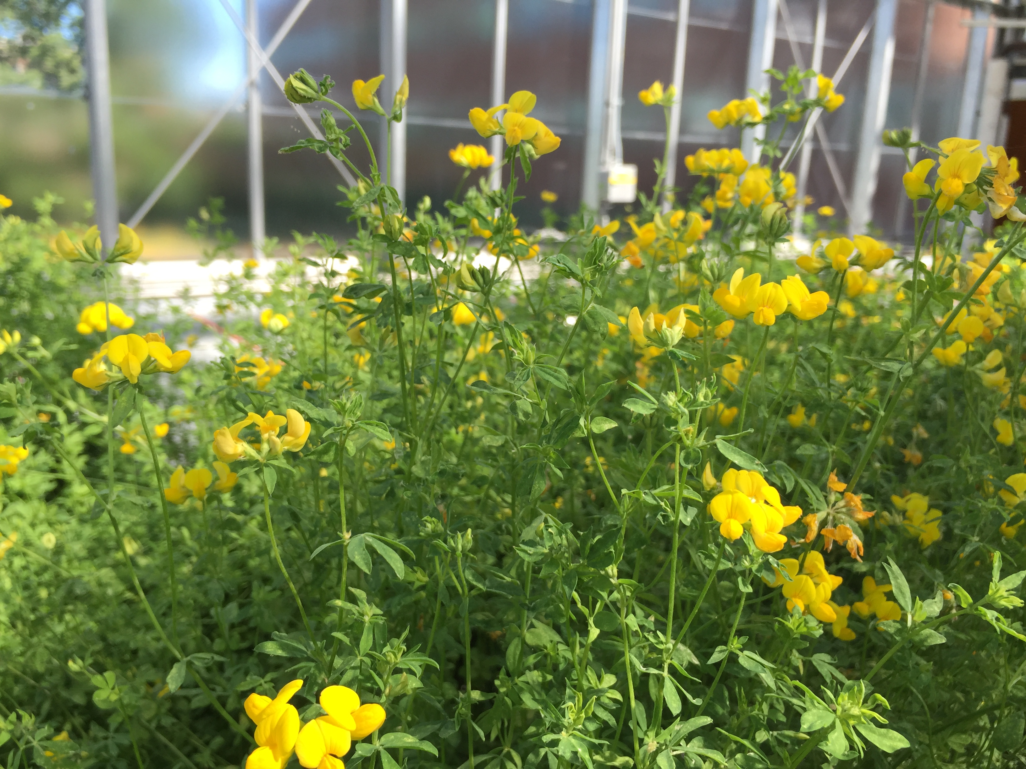
Notes:
We used 3 different plant species to test if some plant species are better are harboring viruses than others. Reasons to believe there might be: For instance floral morphology could matter.. If viruses are shed through fecal matter, plants that only come in contact with the front part of the bee would be less likely to harbor viruses. If the amount of time a bee spends on a flower matters, than flowers with more difficult to access nectaries might be more likely to become infected.

Slide 27
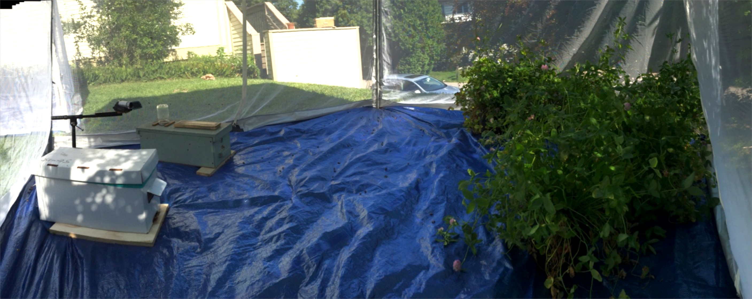
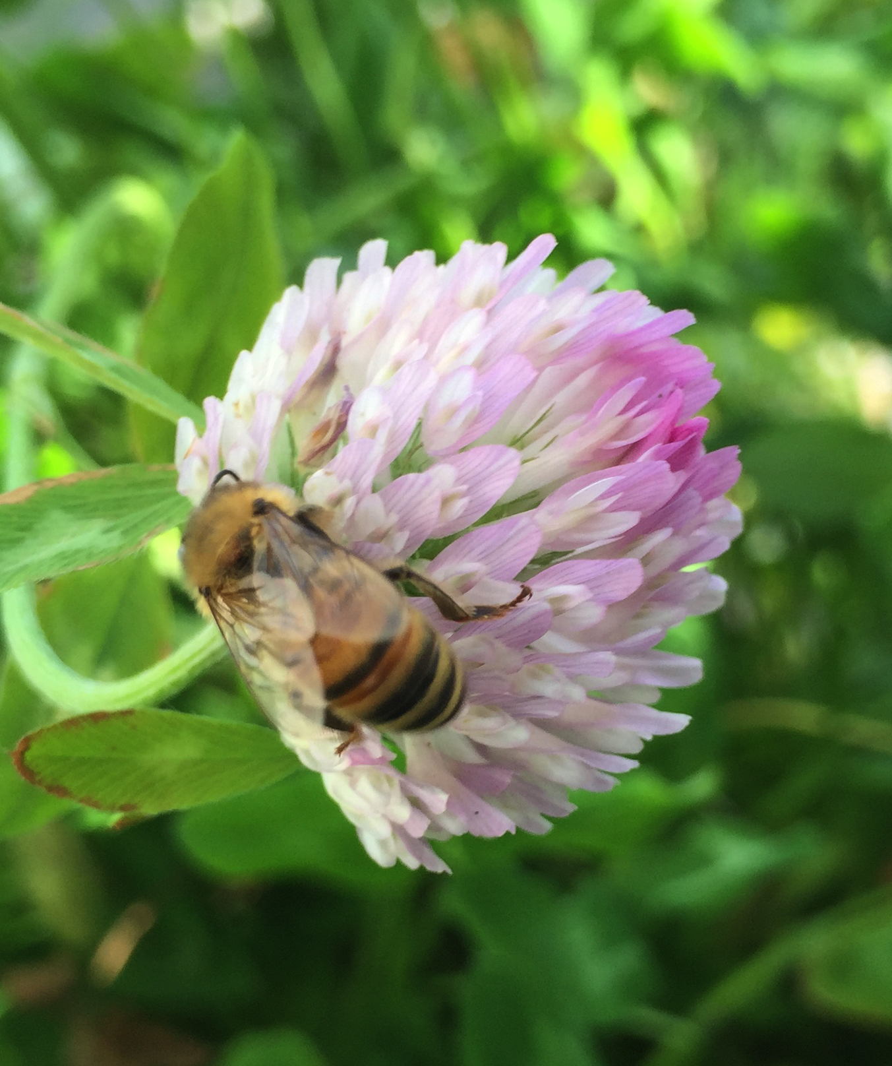
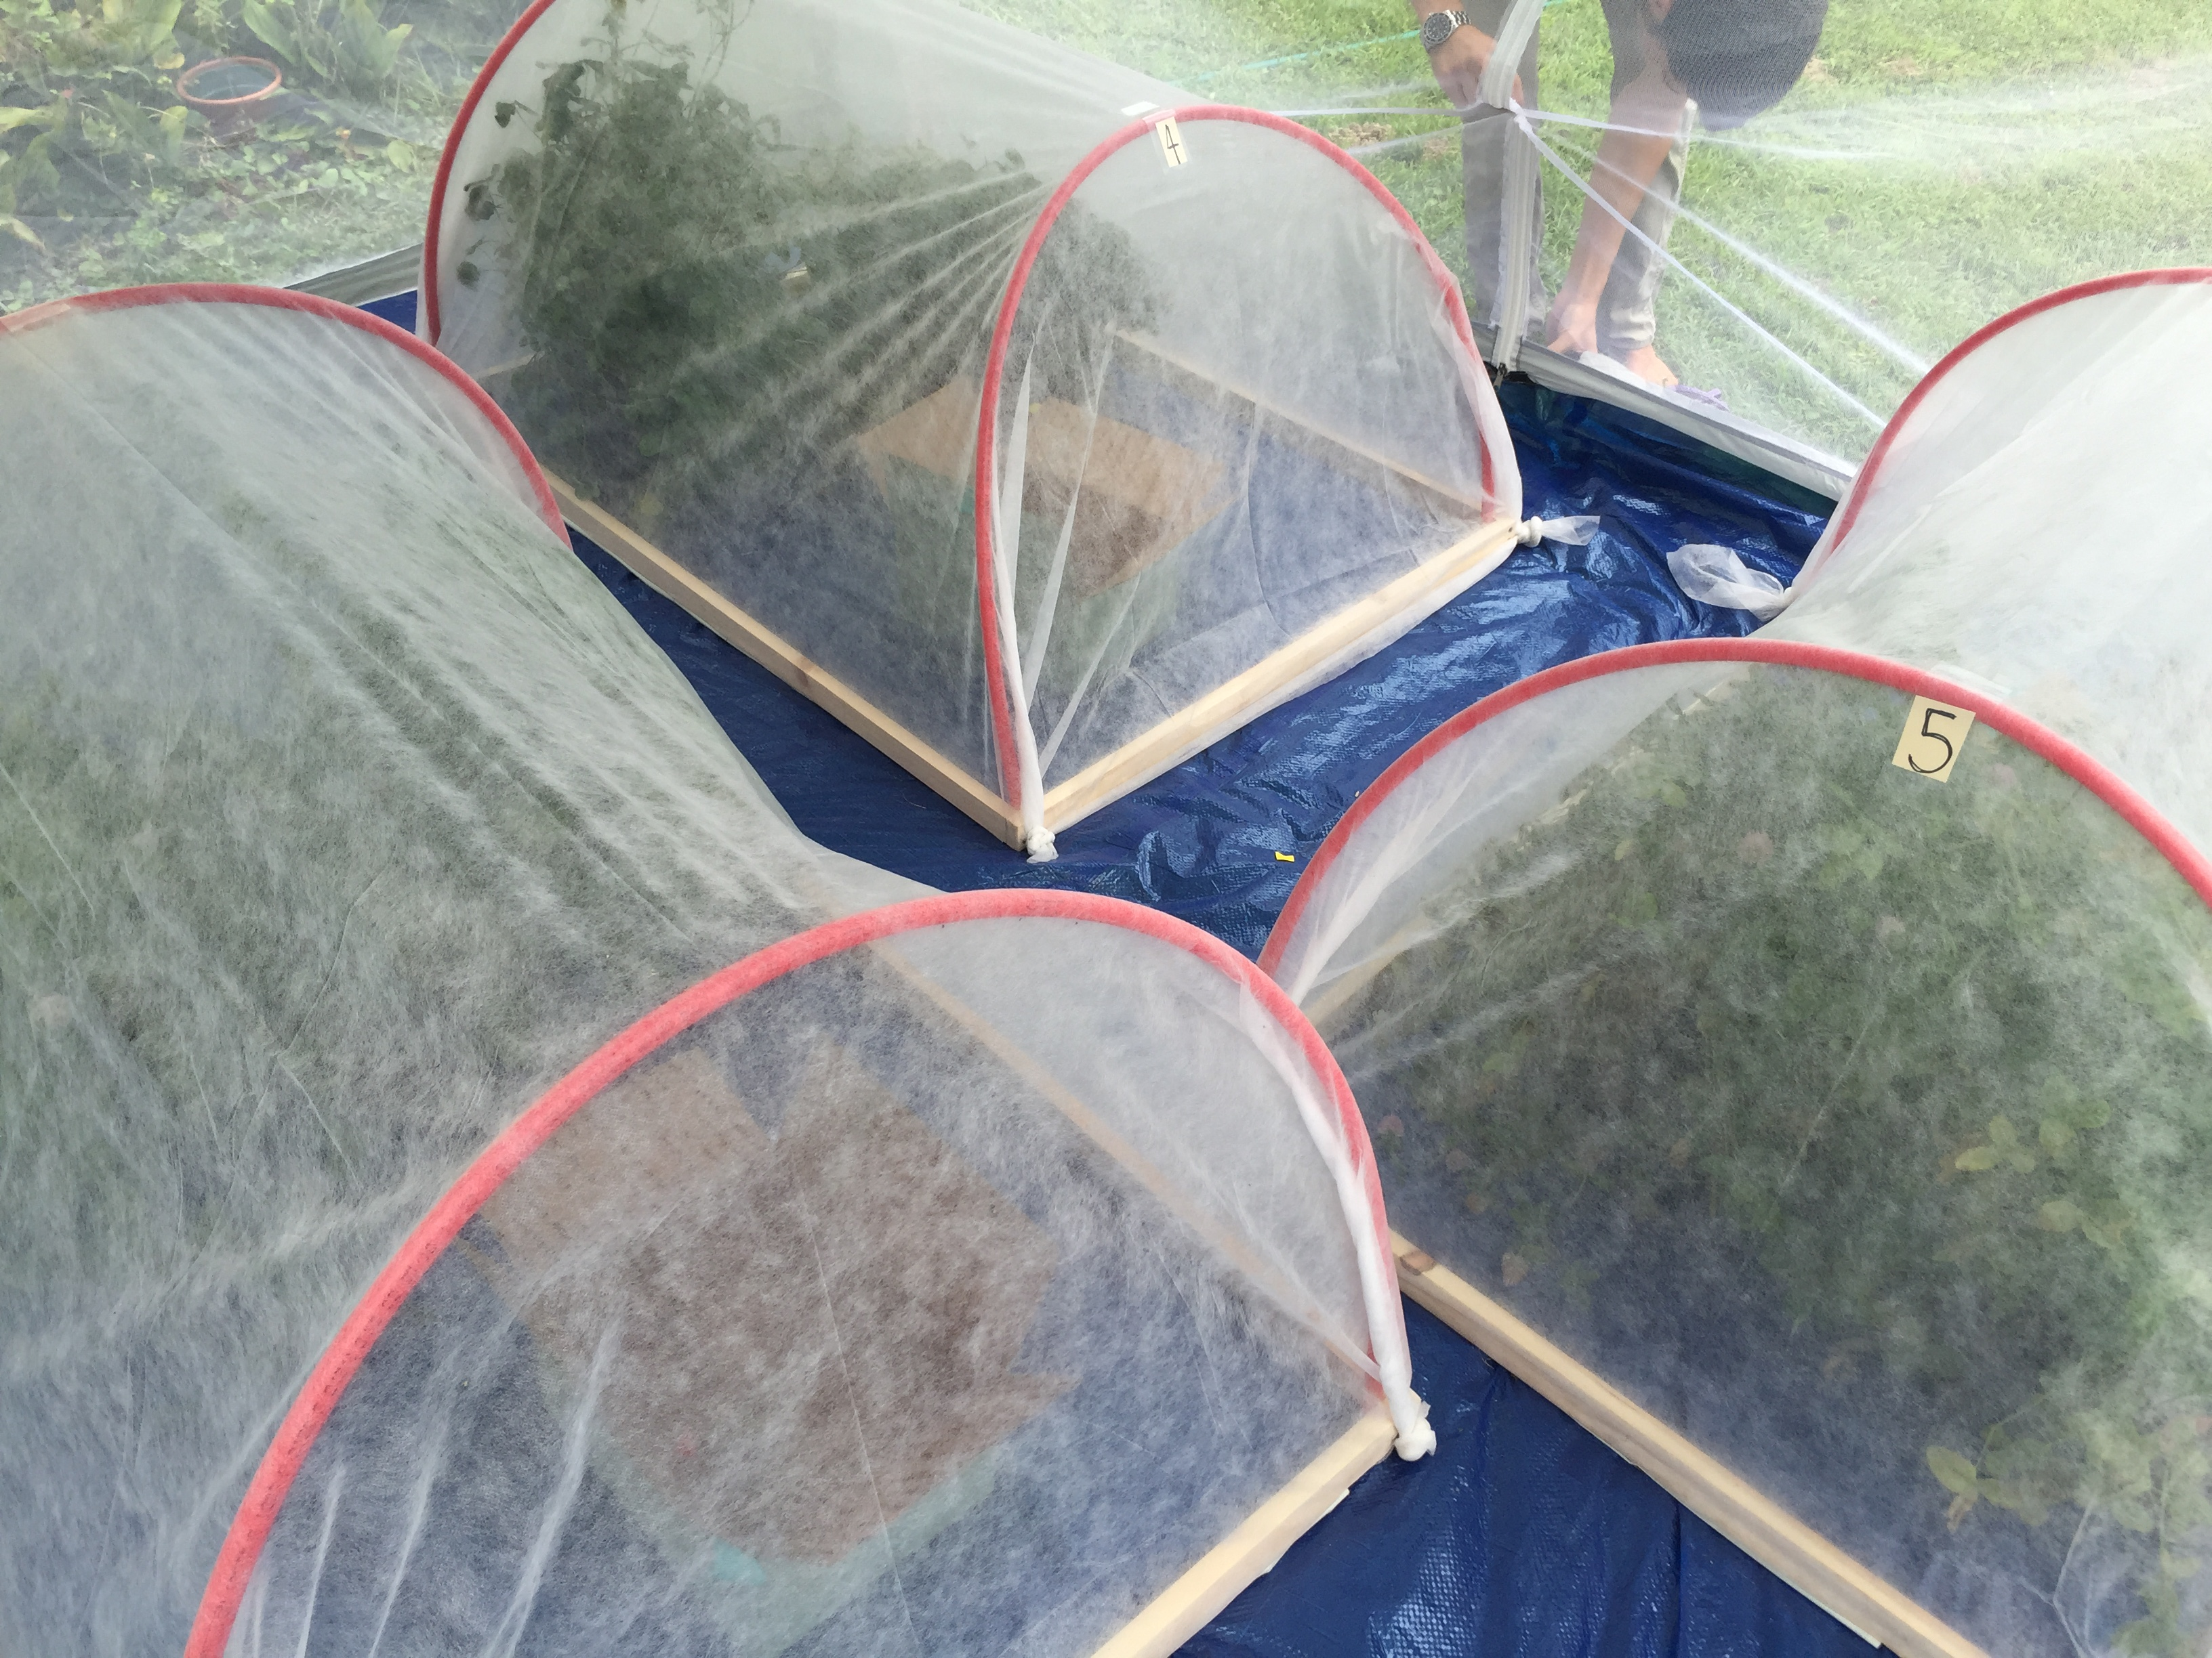
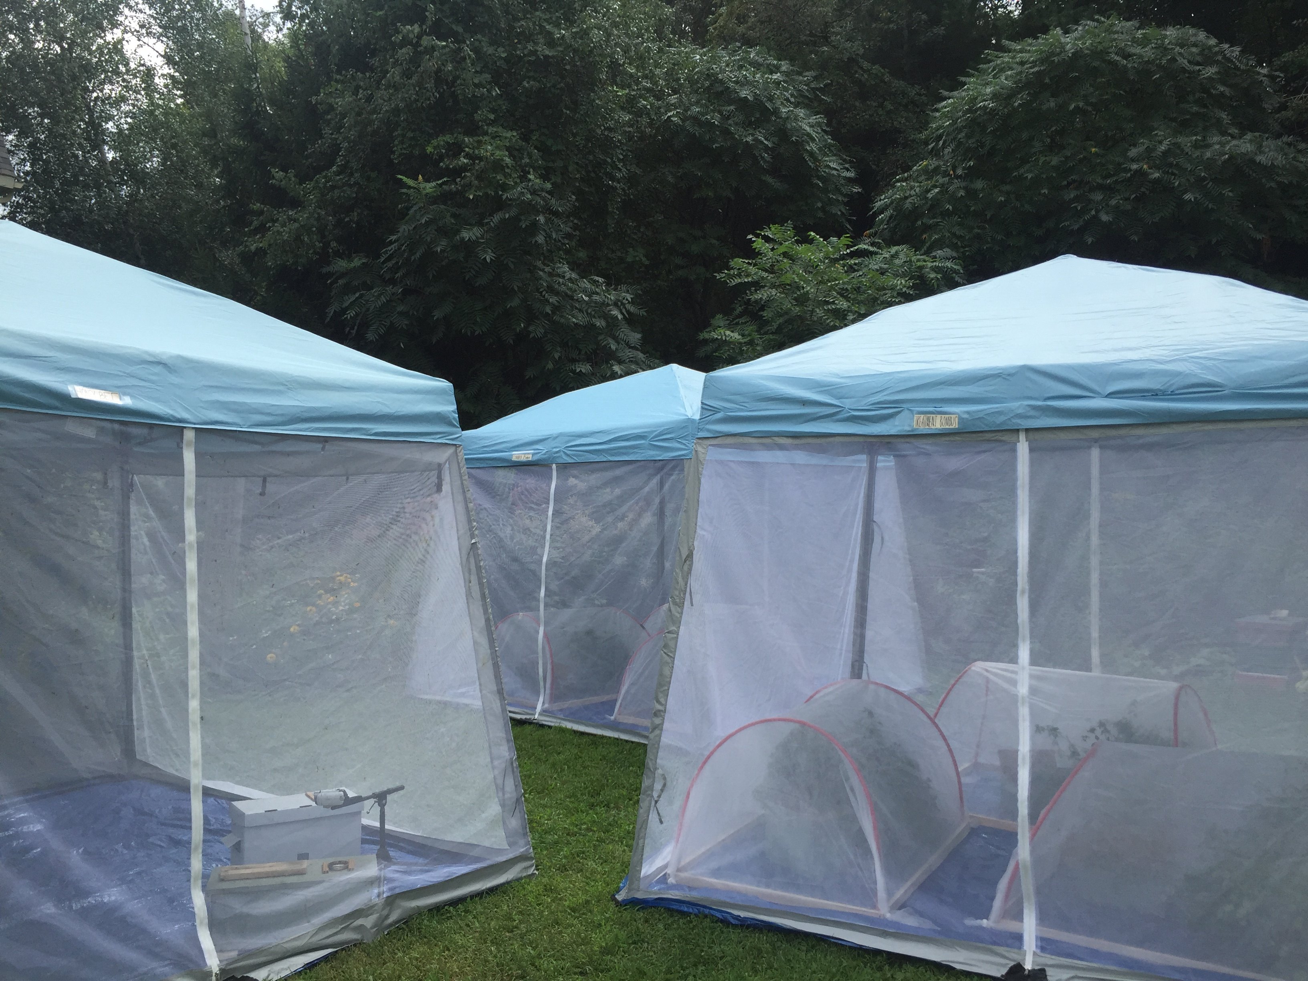
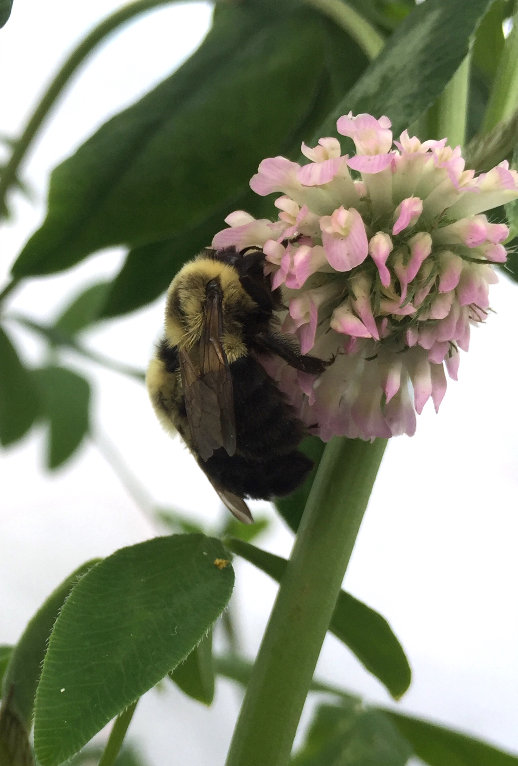

Slide 28
Only Honey Bee + Bumble bee Visited Flowers Had Viruses
Notes:
The first experimental evidence demonstrating that bees can leave viruses behind on flowers while they forage. Here, we only detected viruses on flowers that were exposed to both honey bees and bumble bees. Now, you remember we tested 3 different plant species

Slide 29
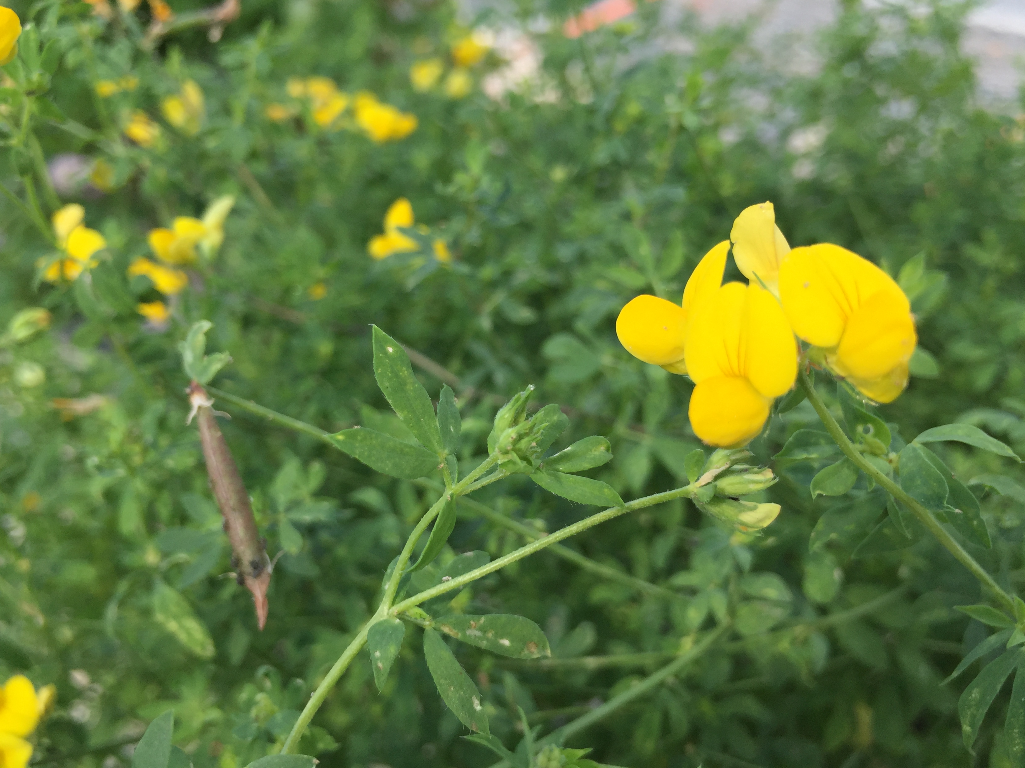
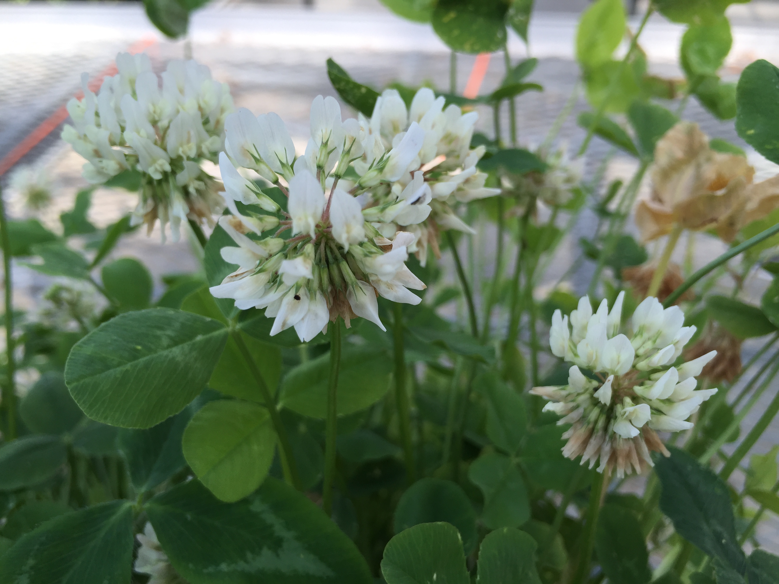
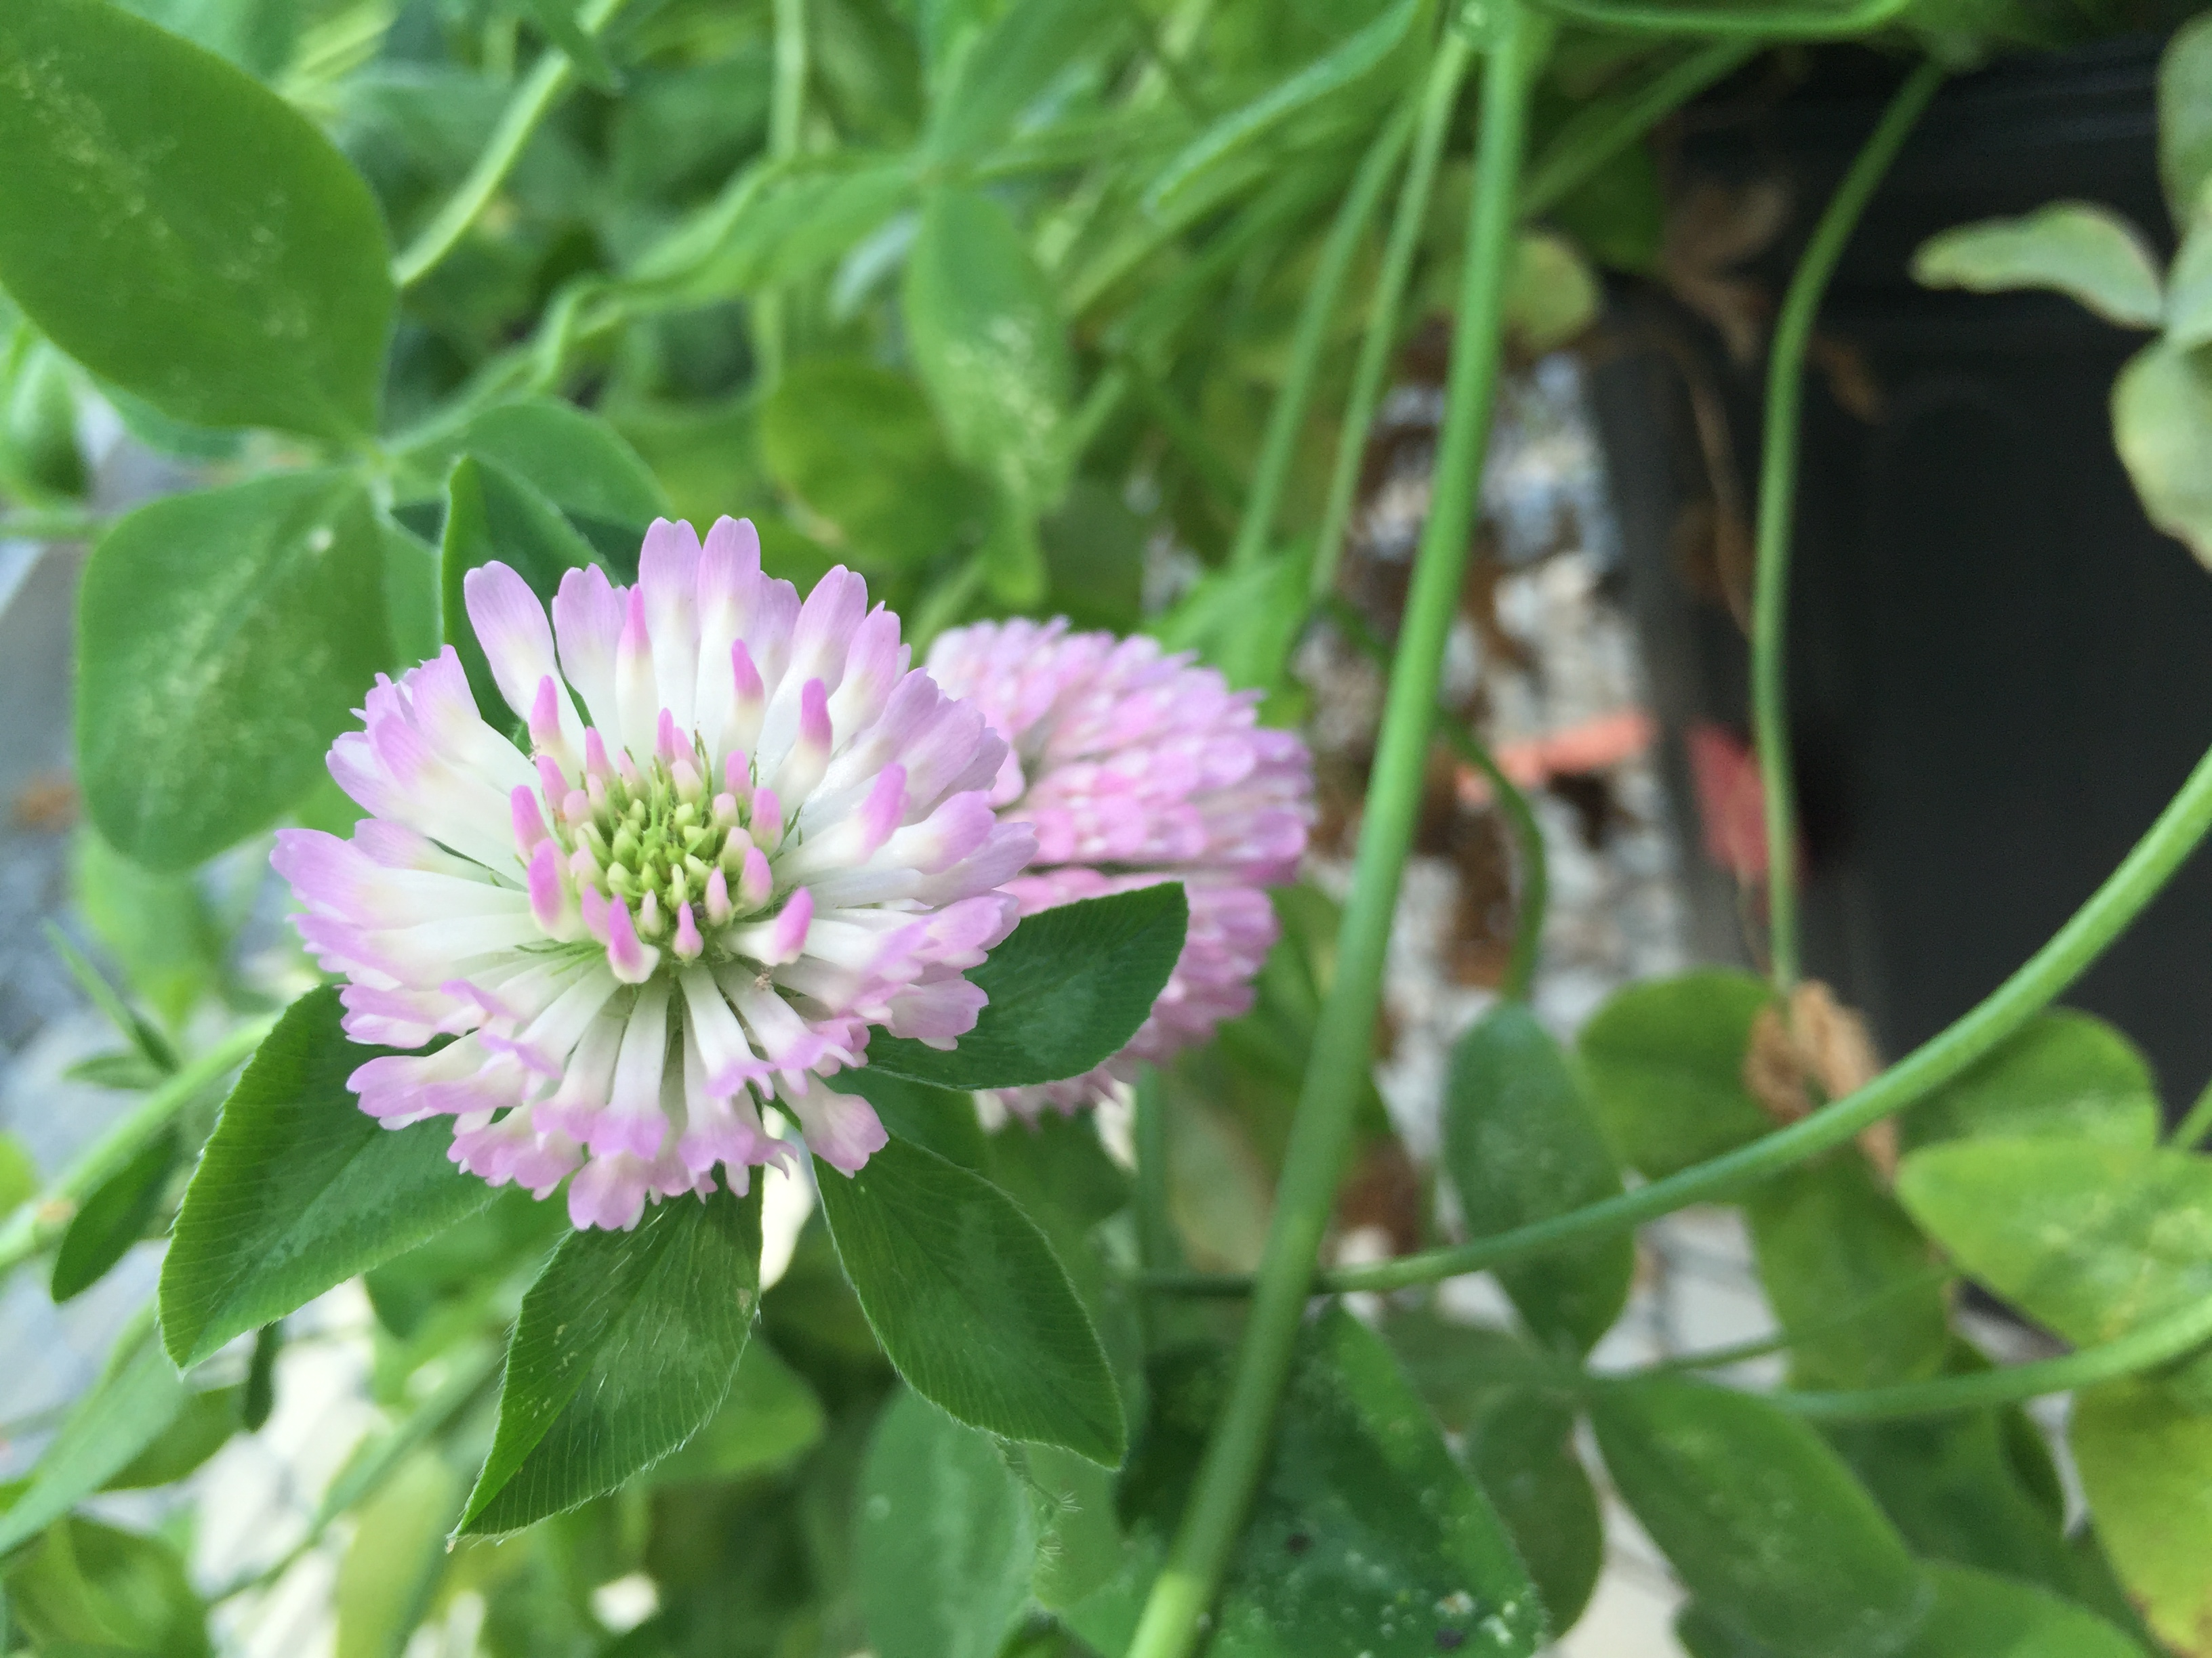
Does plant species matter?
Notes:
If particular plant species are ‘better’ at harboring viruses, they might be avoiding in recommendations for ‘pollinator friendly’ plantings.

Slide 30
Notes:
Looking at just the plants that were exposed to both the honey bees and bumble bees, we can look at differences across plant species. The question here, was, are particular plant species better at harboring viruses than others. From these results we see that particular plant species are more likely to harbor viruses but, interestingly, it seems to be virus dependent. We just recently got these results and are working to make sense of these unexpected results.

Slide 31
Research Questions
Part I.
What is the prevalence of RNA viruses in bumble bees
BQCV is most common, followed by DWV
Is there evidence for disease spillover from managed honey bees?
Yes- bumble bees are more likely to be infected when caught near an apiary and when the apiary has high viral loads
Part II.
What is the role of flowers in disease transmission?
Bees can deposit viruses on flowers
Plant species and virus matter!

Slide 32
Questions for future work…
Can bees become infected after visiting an infected flower?
Are there differences in how viruses are shed?
(Fecally vs. Orally)
Does floral morphology matter?
Notes:
Does plant diversity matter?
Can bumble bees get infected after visiting an infected flower?
Can bumble bees leave viruses behind too?

Slide 33
Implications…
BQCV is common in bumble bees and its effects should be studied
Reducing honey bee viral loads (mite management) could lessen spillover of DWV
Recommendations for ‘pollinator friendly’ habitat
Notes:
Does plant diversity matter?
Can bumble bees get infected after visiting an infected flower?
Can bumble bees leave viruses behind too?

Slide 34








Contributors & Collaborators
Alex Burnham
Vermont Beekeepers
Leif Richardson
Melanie Kazenel
Anna Smith & Caitlin Danehy
Andrew Nguyen
Edward Alger
Alison Brody
Joseph Schall
Sara Helms Cahan
Taylor Ricketts
Fabri Fialho Research Award
Ronald Suiter Travel Prize

Slide 35
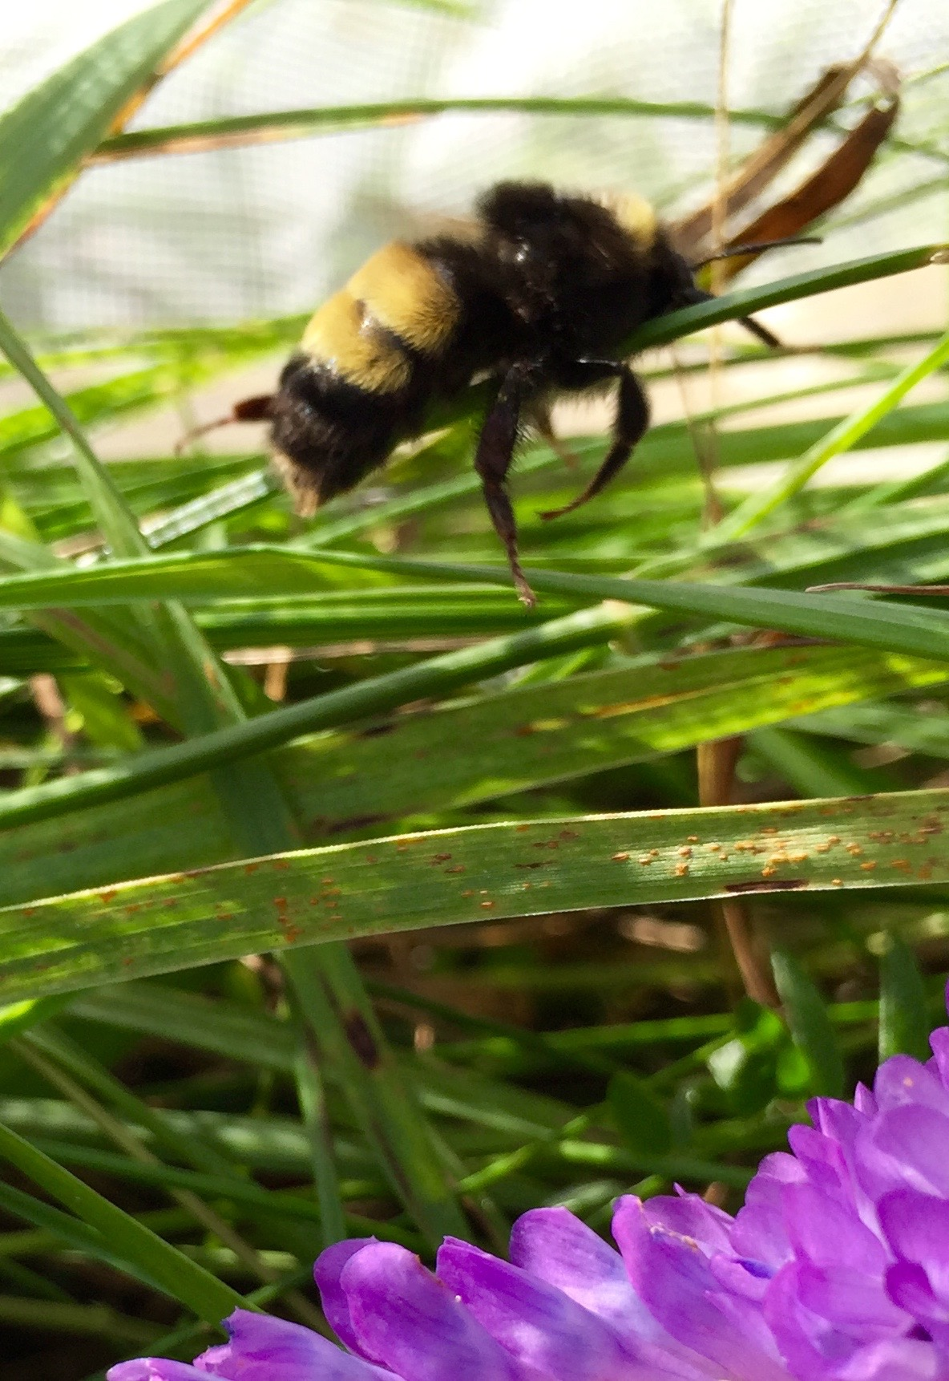
Notes:
During the survey in 2015, at each site, I measured plant diversity and density for each site. If flowers played a role in disease transmission, you might expect dense flowering areas to be hot spots for disease transmission, with lots of bees attracted to the site. Alternatively, you might these areas to have a dilution effect, whereby there are so many flowers, bees are less likely to come into contact with infected flowers and less likely to develop an infection.
Analyzing these data, we found a positive correlation indicating that plant density at a site influences the bumble viral loads we see at that site. So, at least correlationally, it seems that plants might play a role in patterns we see in bee viruses….We decided to conduct a manipulative experiment testing the roles of flowers and we had some very unexpected results.

Slide 36
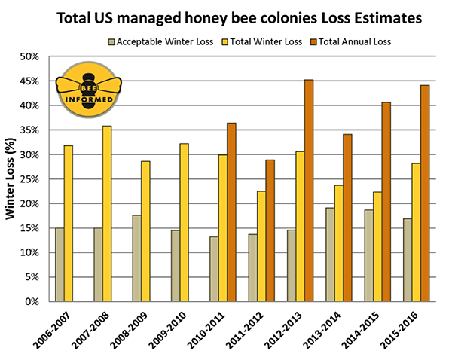

Slide 37
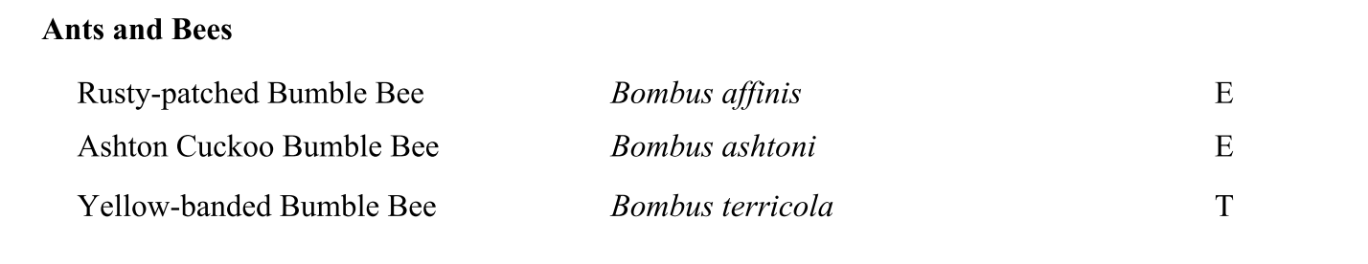
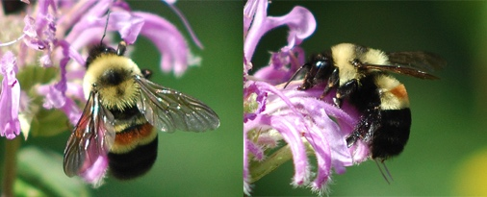
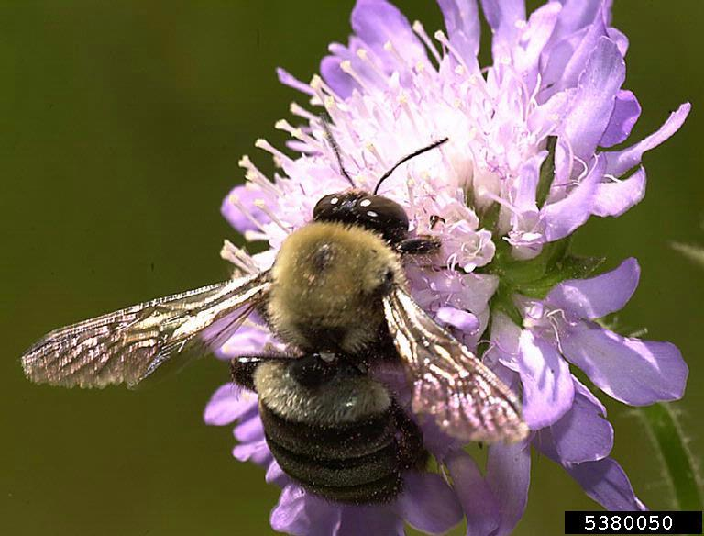
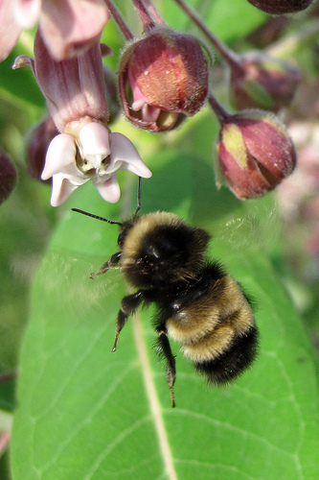
Johanna James-Heinz
Gary Alpert
nbnc

Slide 38
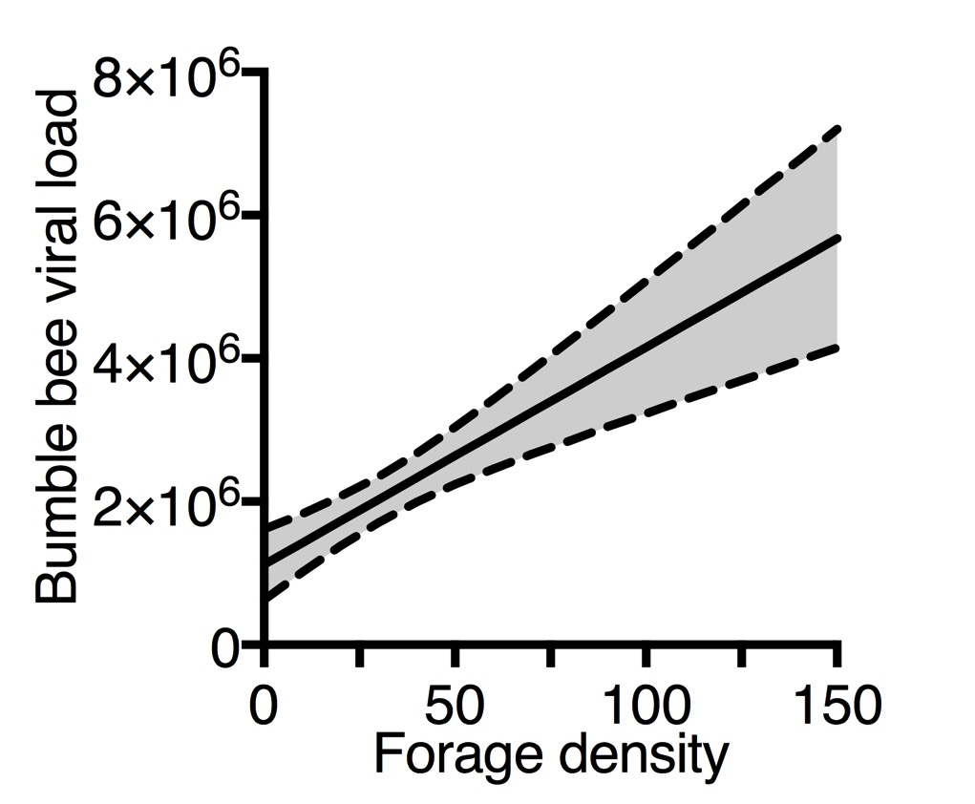
Notes:
During the survey in 2015, at each site, I measured plant diversity and density for each site. If flowers played a role in disease transmission, you might expect dense flowering areas to be hot spots for disease transmission, with lots of bees attracted to the site. Alternatively, you might these areas to have a dilution effect, whereby there are so many flowers, bees are less likely to come into contact with infected flowers and less likely to develop an infection.
Analyzing these data, we found a positive correlation indicating that plant density at a site influences the bumble viral loads we see at that site. So, at least correlationally, it seems that plants might play a role in patterns we see in bee viruses….We decided to conduct a manipulative experiment testing the roles of flowers and we had some very unexpected results.

